Slide 1
EAT@ ONLINE FOOD DELIVERY SYSTEM
RLL PROJECT
BATCH 6

Slide 2
Batch Members
Name of the Developer Employee ID
Prathijna R Udupa 2527946
Pullagura Vamsi 2525905
Rahul Kumar 2525728
Rayala Lokesh 2528561
Rizvi Sultana M A 2530100
S Berlin 2526684
Sangeetha J 2526763
Sanofer Fathima Zahir Hussain 2530388
Santhosh S 2526510
Sarnika K 2527426

Slide 3
TABLE OF CONTENTS:
Table of Contents
S.No Content
1. Title
Batch Members
3. Table of Contents
4. Introduction
5. Functional Requirements
Tools and Technologies
7. Angular Architecture
8. Spring Boot Architecture
9. Total Project View
10. Flowcharts
11. Database Architecture
Database Schema
Implementation Images
14. Testing Images
15. End

Slide 4
Introduction
Project :
To create a dynamic and responsive online food delivery web application for online ordering of food items of different cuisines from a restaurant.
Main Objectives:
To provide a bug free online food delivery system to users as well as admin.
The main aim here is to provide a nice and secure platform for Ordering food.
To maintain the records of product, category available into the system.

Slide 5
Admin Functionalities:
1.Login to portal
2.Add or remove cuisines to or from the application to build a rich product line
3.Edit food item details like name, price, cuisine and description.
4.Delete food items
Add Dish
Edit Dish
Admin Stories
Delete Dish
Login

Slide 6
User Functionalities:
1.Register to the application
2.Sign into the application to maintain the record of activities
3.Search for food items based on the search keyword
4.Apply filters and sort results based on different cuisines
5.Add all the selected food items to a cart and customize the purchase at the end
6.Perform a payment process
7.Summary of the order
Search
Product
Login
Add to Cart
Buy the Product
Register
User Stories

Slide 7
Tools And Technologies
Technologies:
Angular
Java Spring Boot
MySQL
Tools:
1.Visual Studio Code
2. Spring Tool Suite
3.MySQL Workbench
4. Postman
5. Tomcat Server

Slide 8
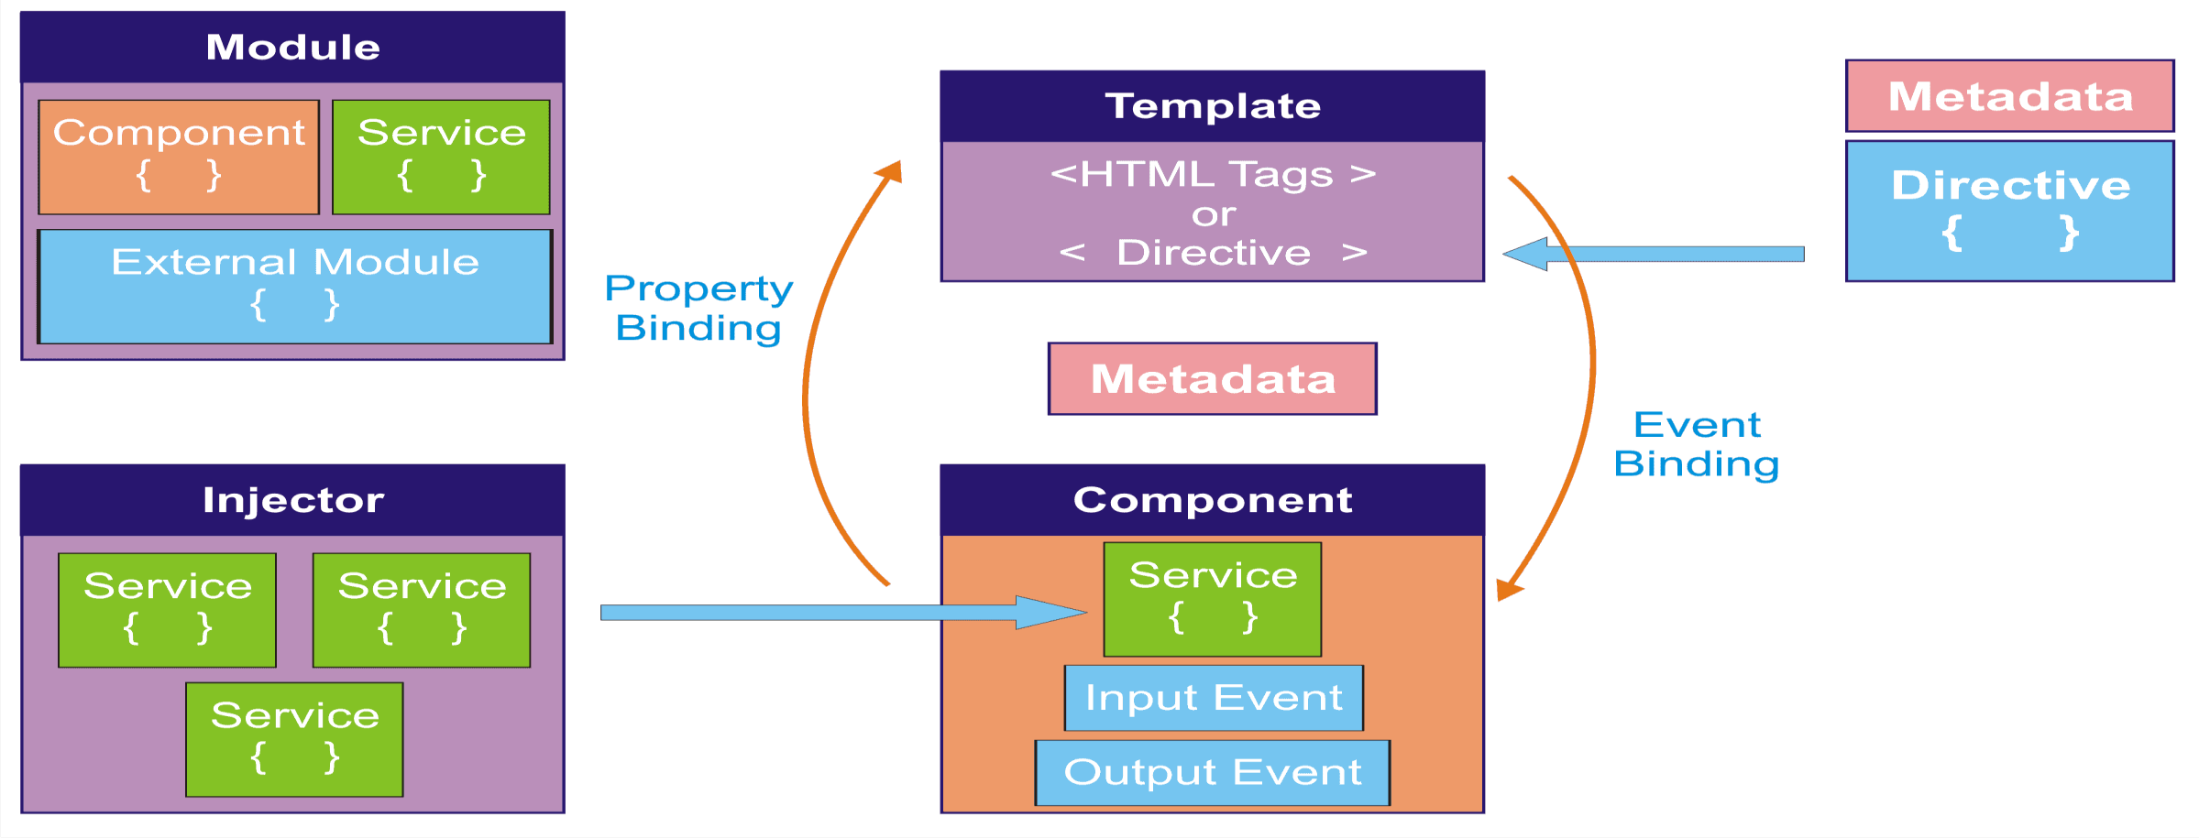
Angular Architecture

Slide 9
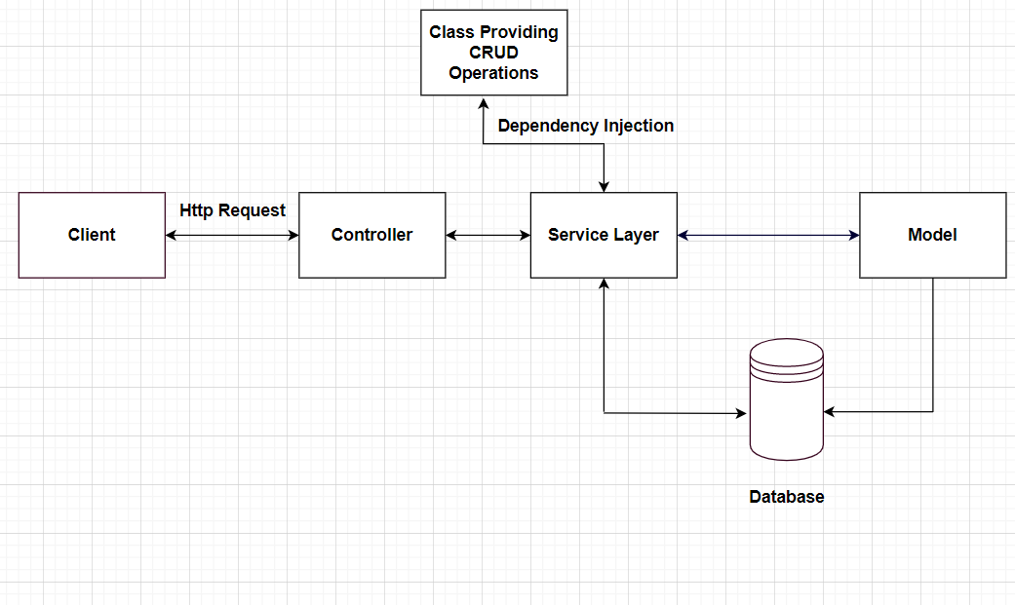
Spring Boot Architecture

Slide 10
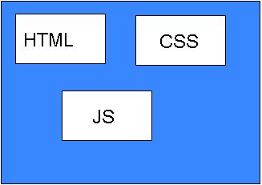
Total Project View
Back-end
Front-end
Backend Lang Application
Database
User
Web Browser
Web Server

Slide 11
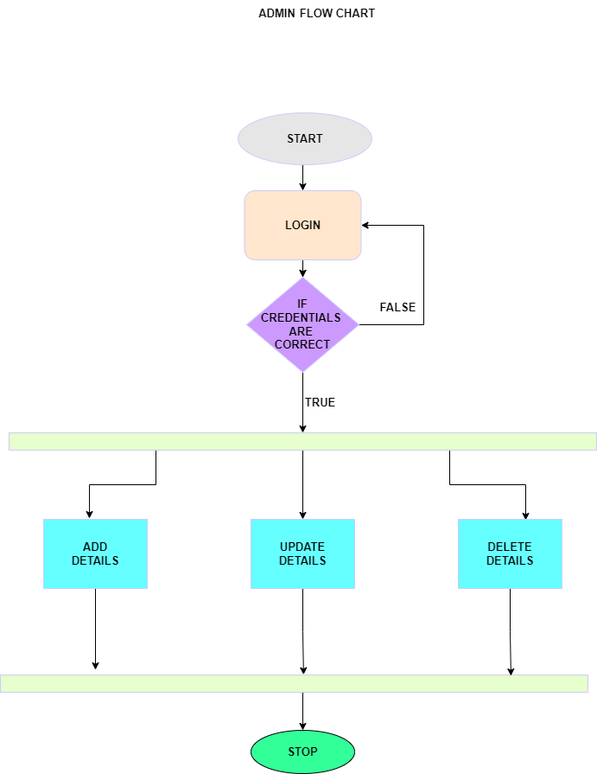
FLOW CHART:
Admin Flowchart:

Slide 12
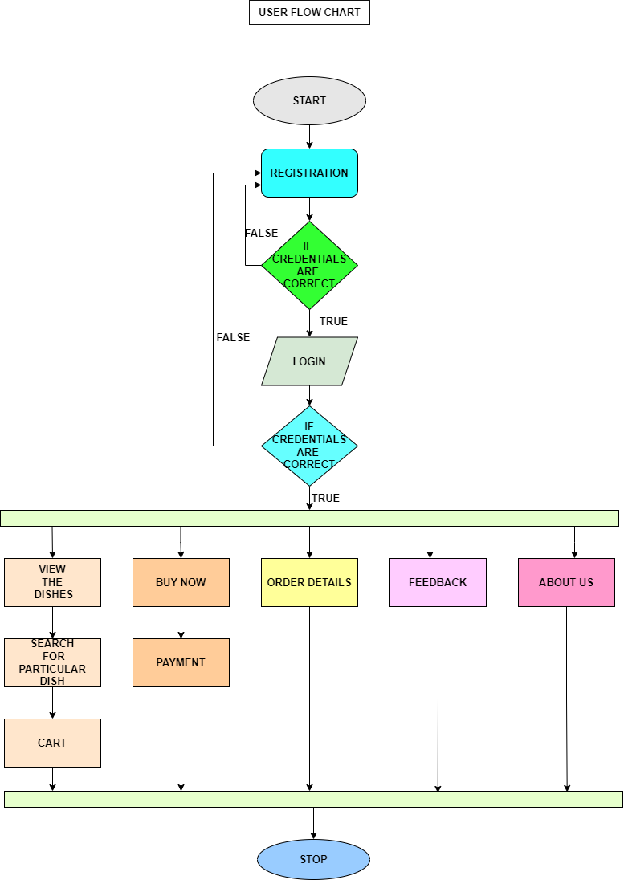
User Flowchart:

Slide 13
Database Architecture
Entities in the Database:
User
Dish
Cart
OrderDetails

Slide 14
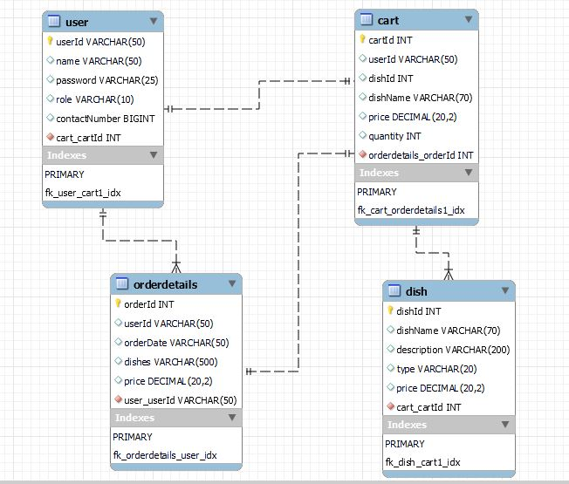
Database Schema

Slide 15
IMPLEMENTATION

Slide 16
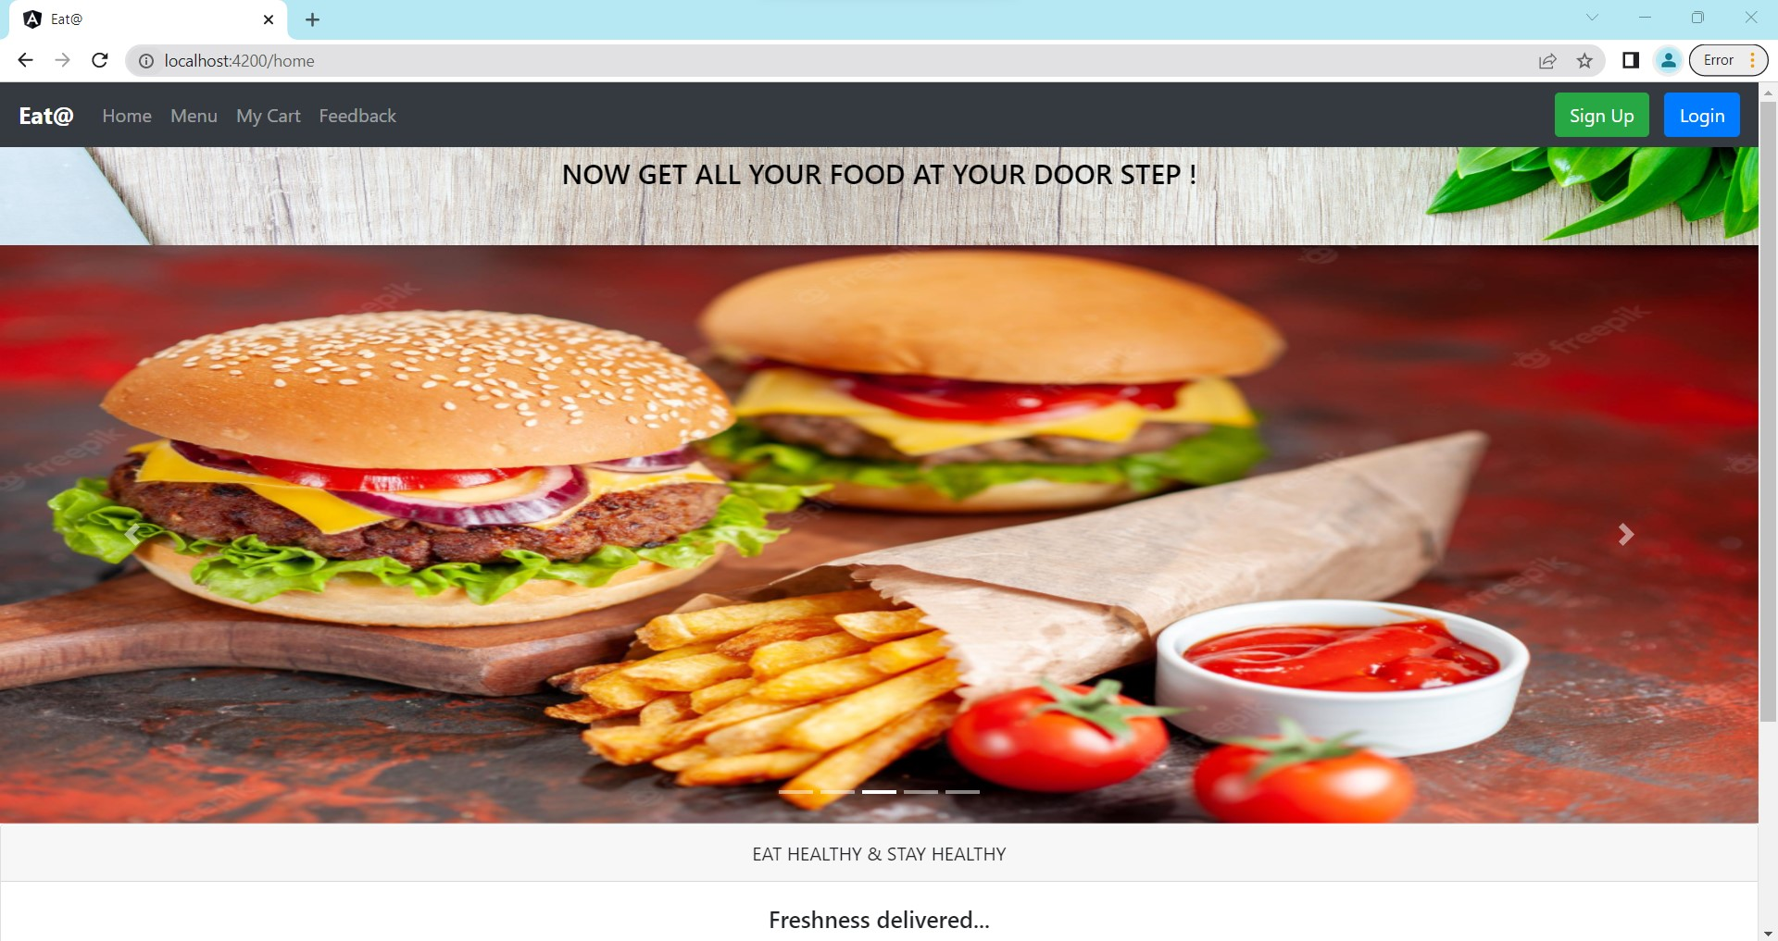

Slide 17
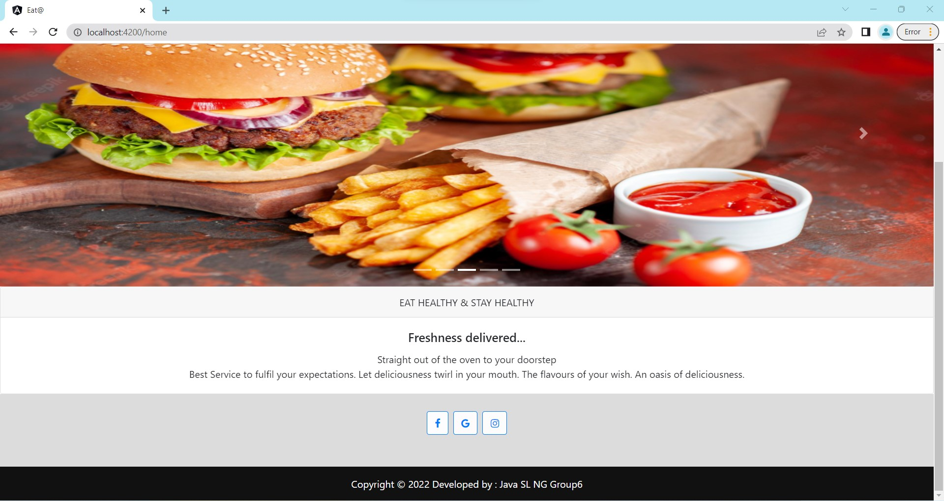

Slide 18
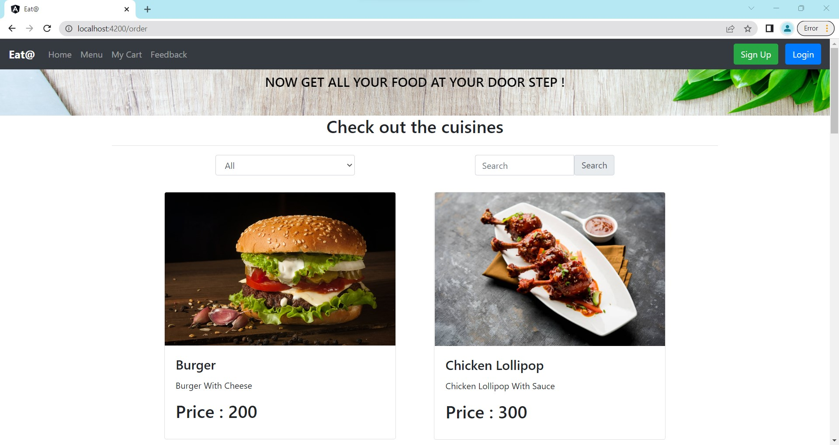

Slide 19
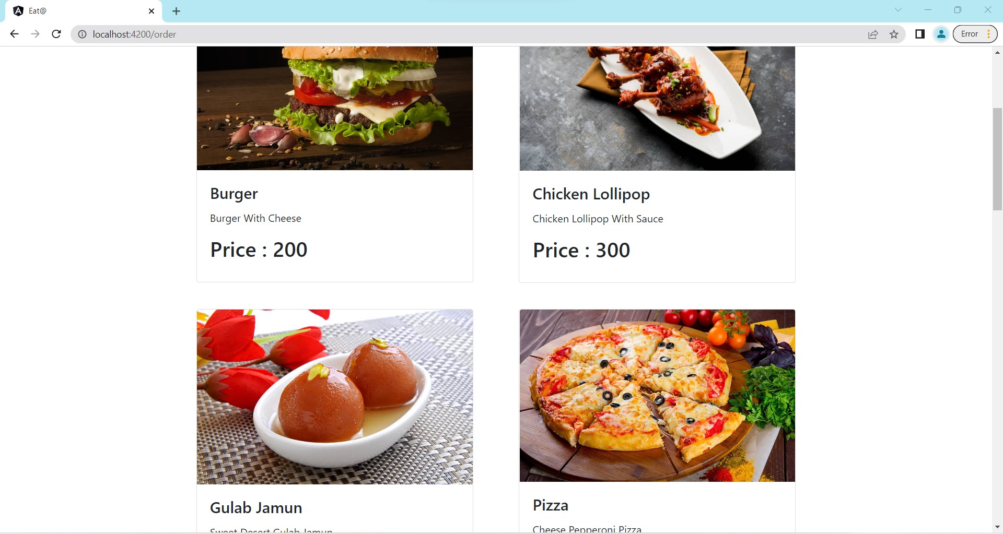

Slide 20
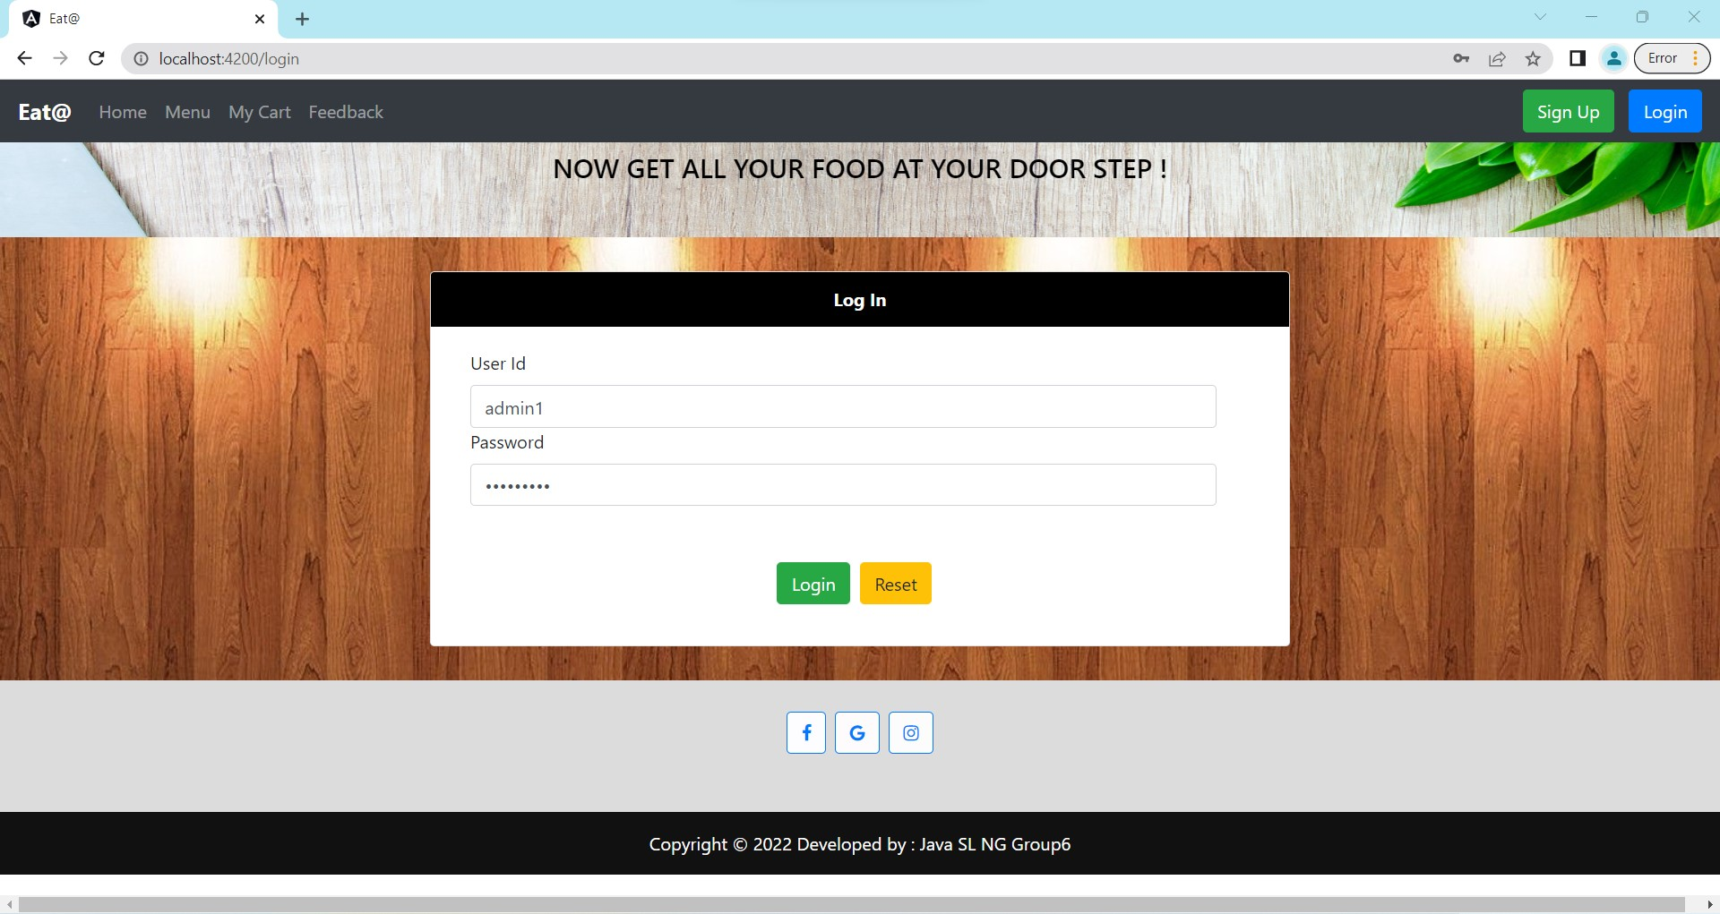

Slide 21
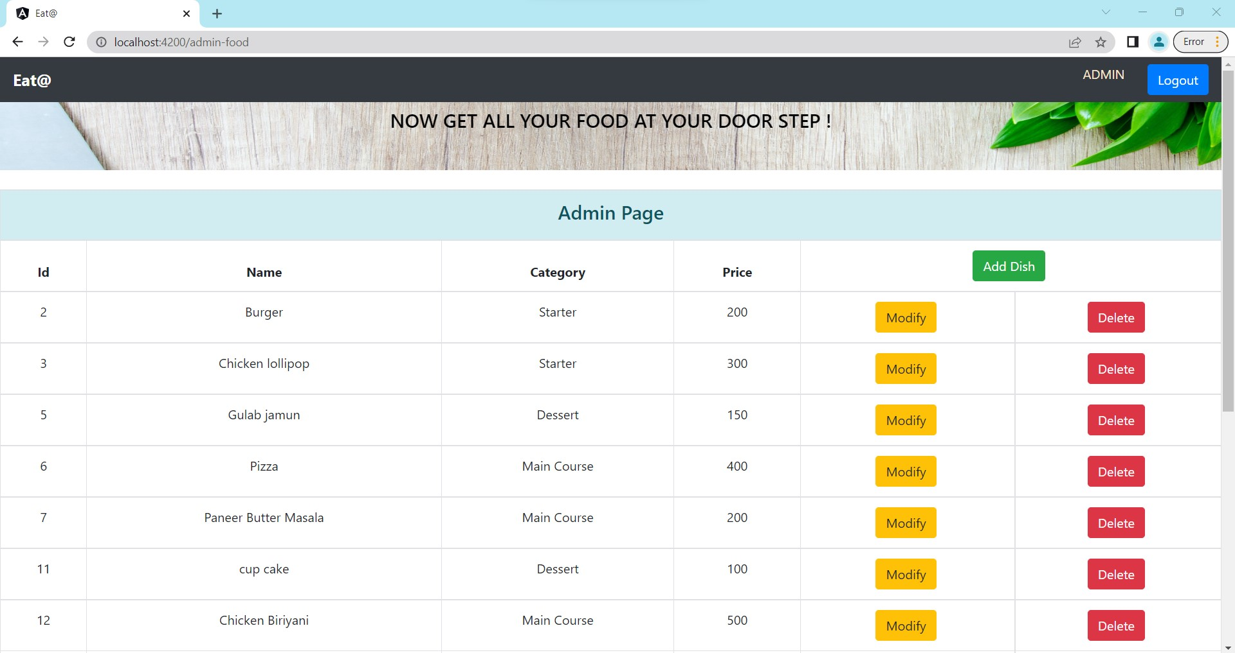

Slide 22
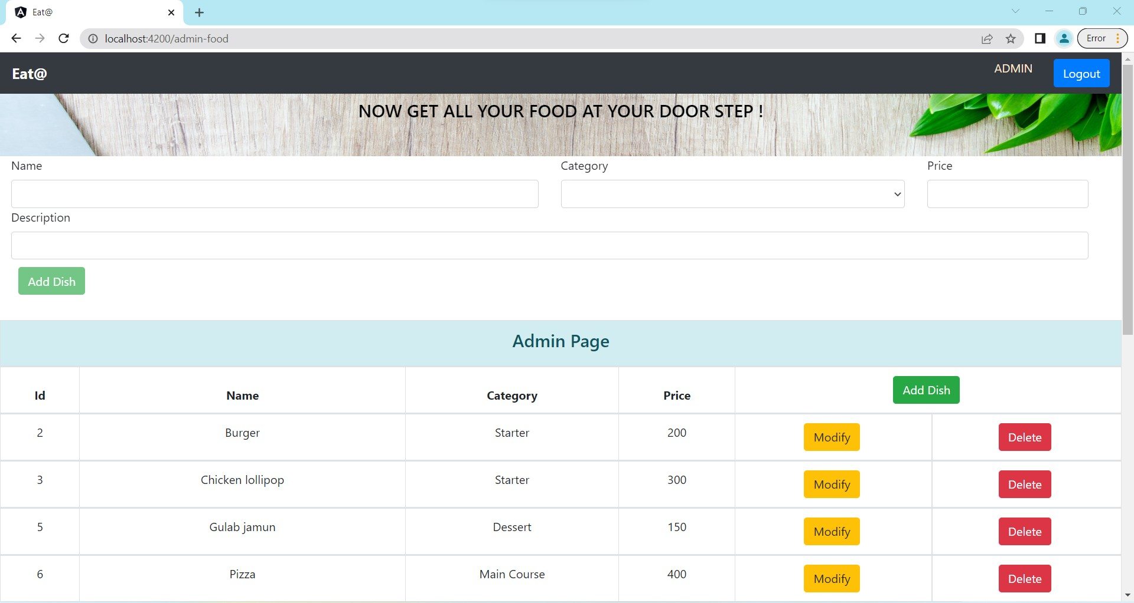

Slide 23
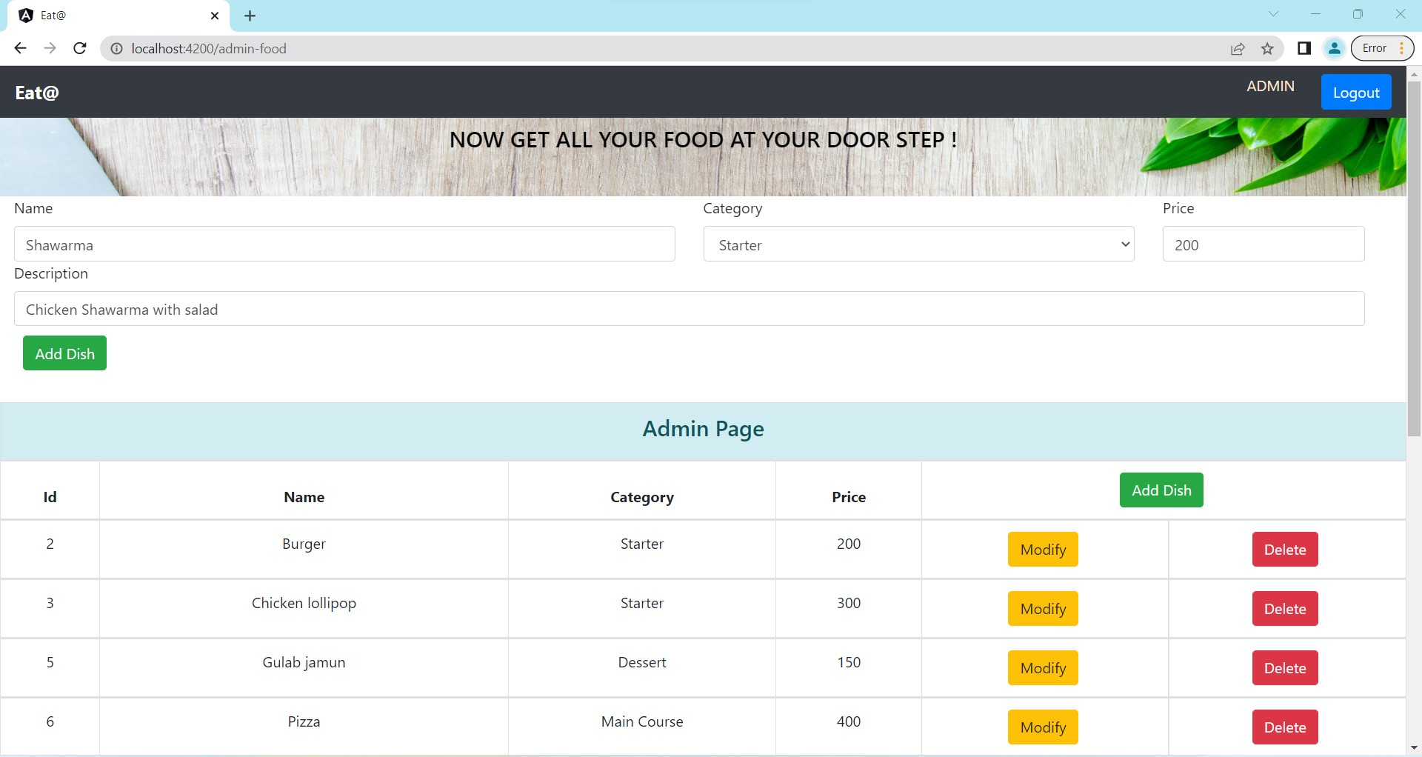

Slide 24
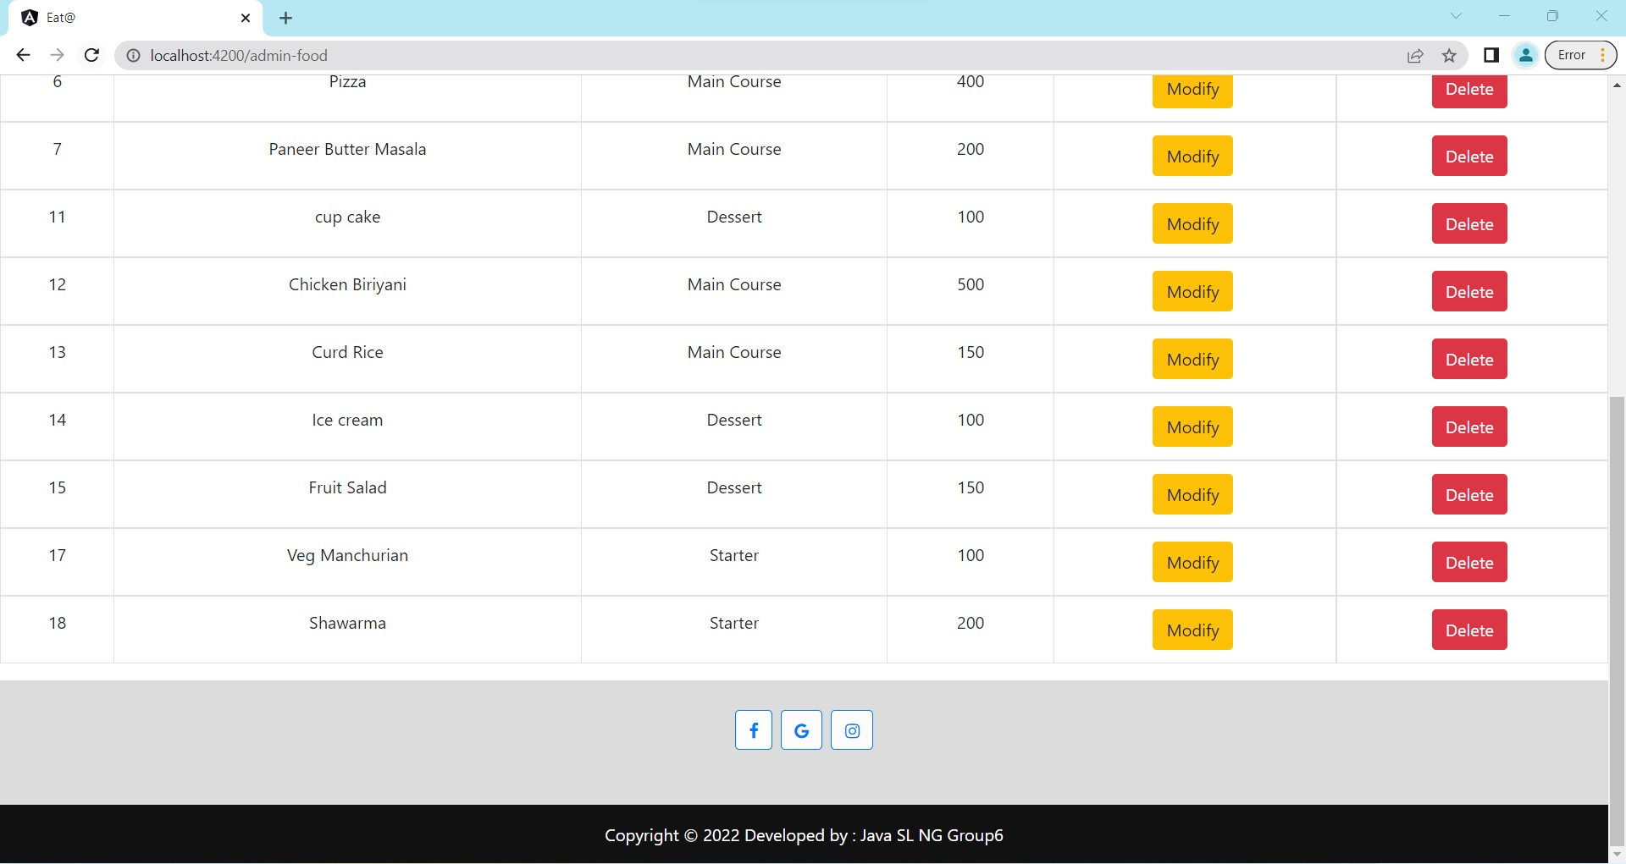

Slide 25
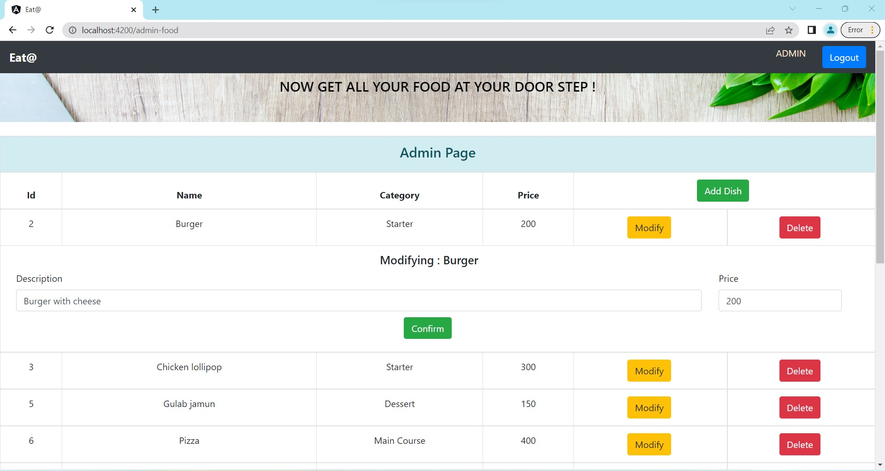

Slide 26
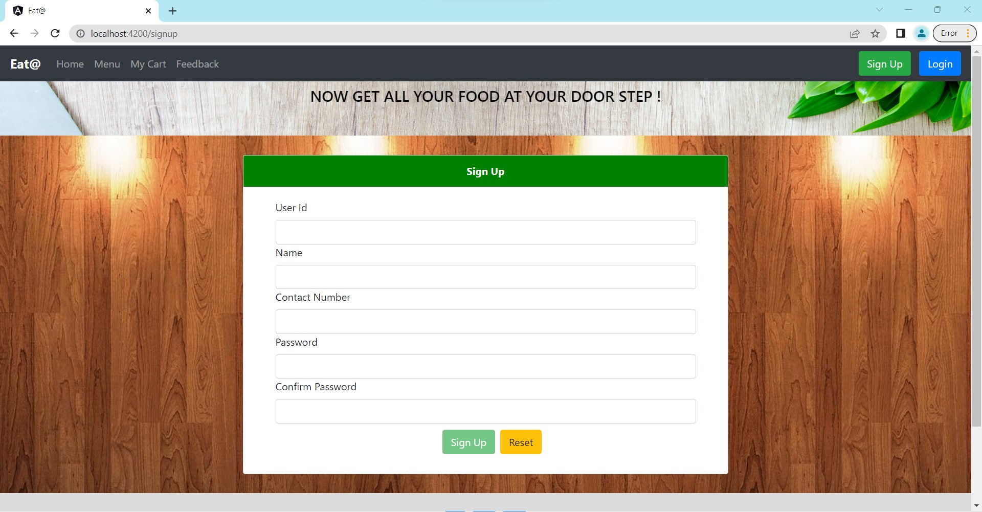

Slide 27
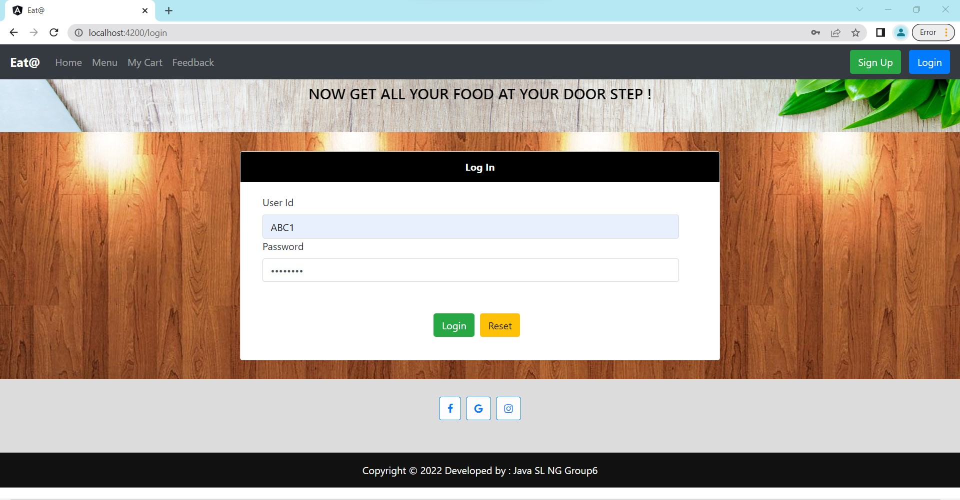

Slide 28
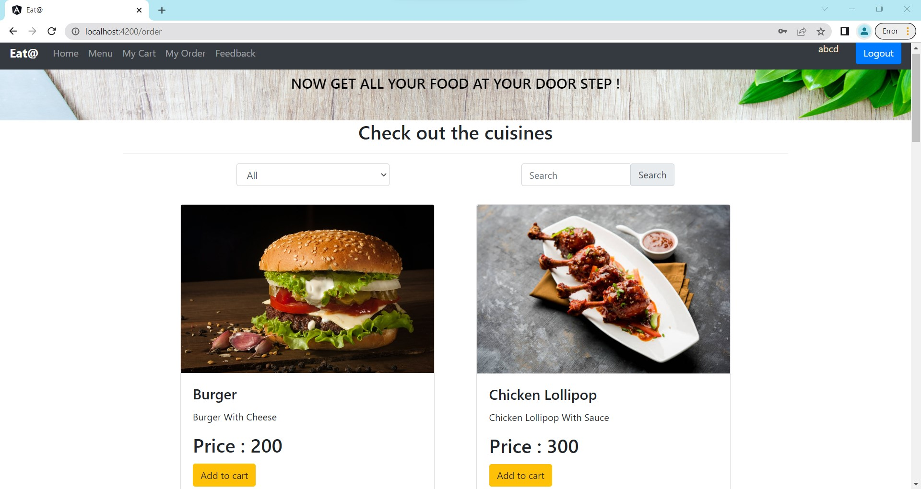

Slide 29
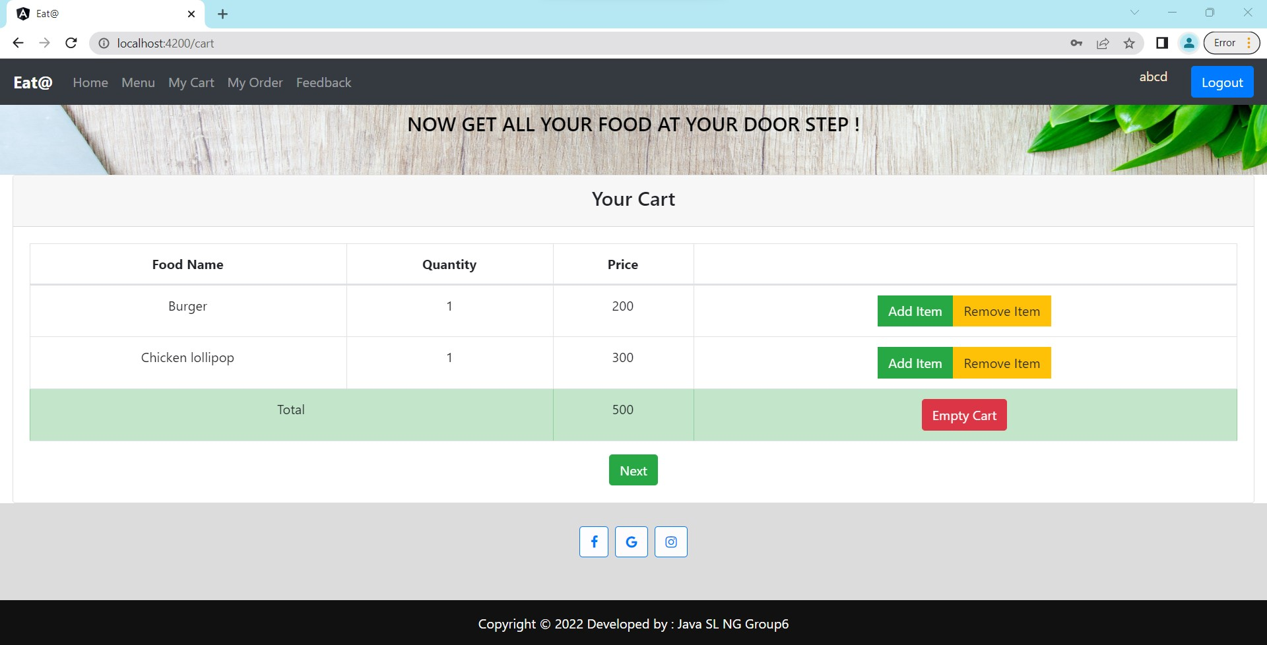

Slide 30
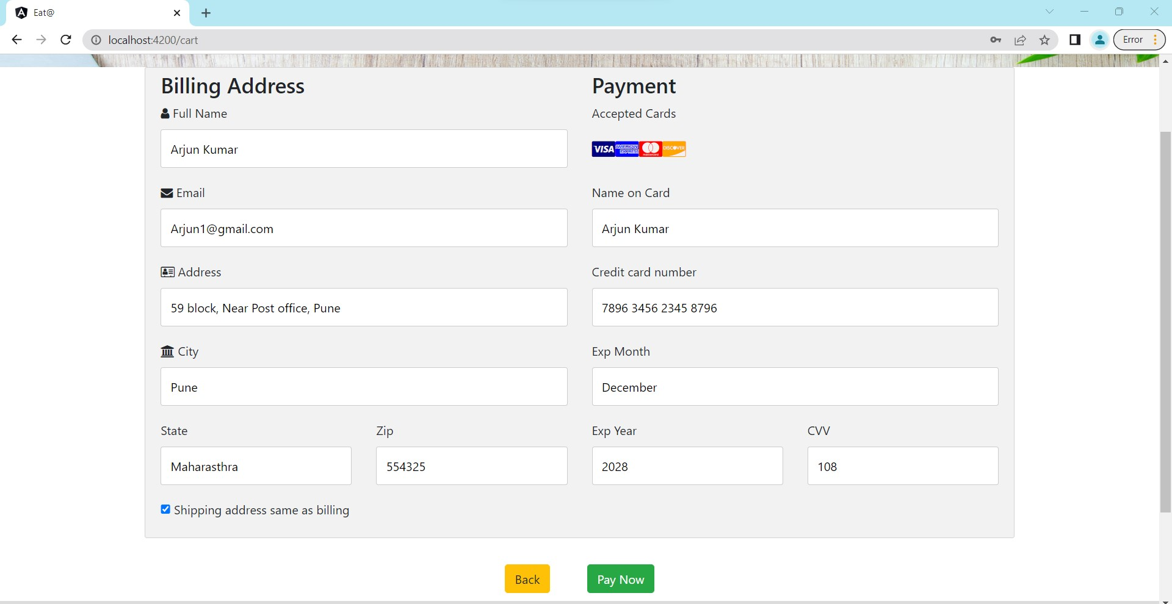

Slide 31
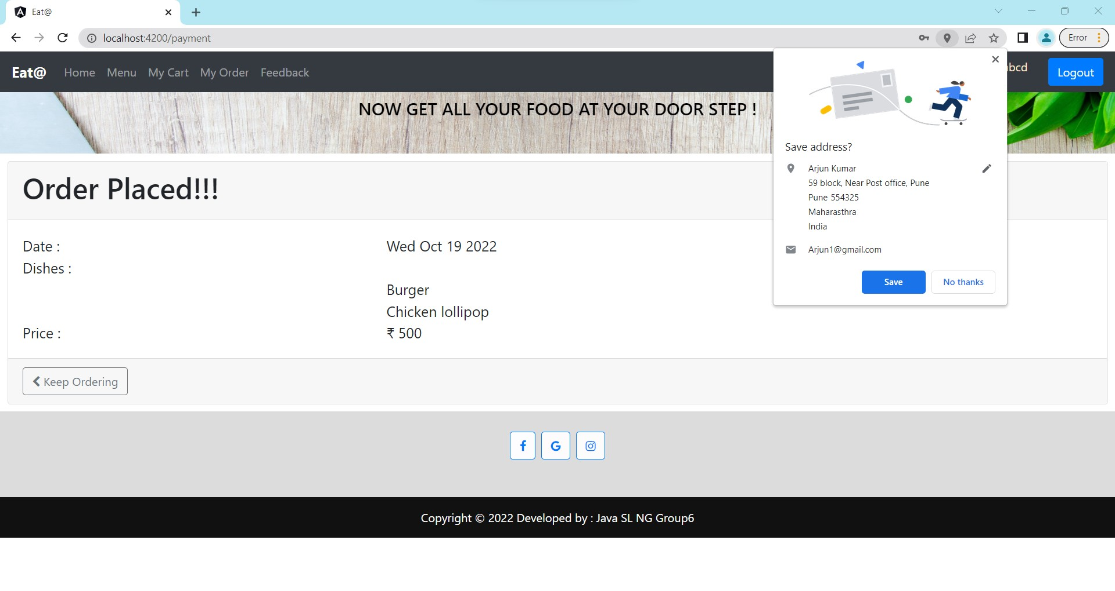

Slide 32
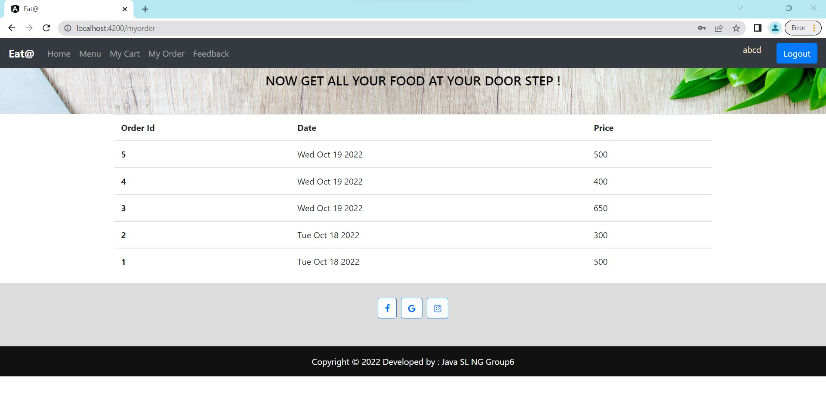

Slide 33
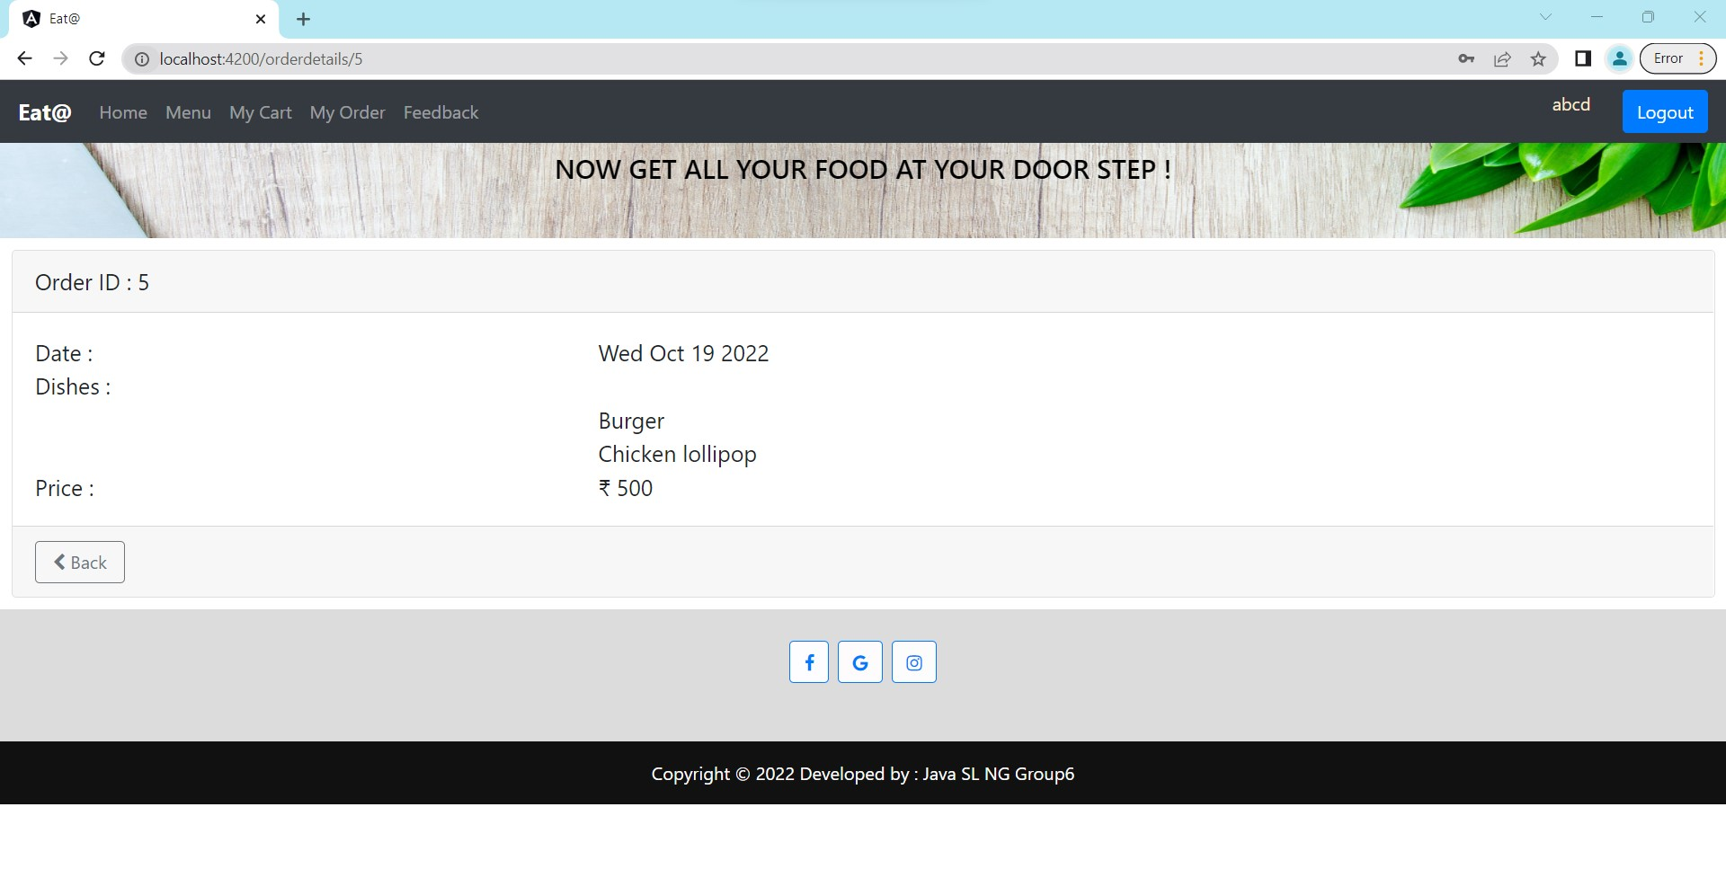

Slide 34
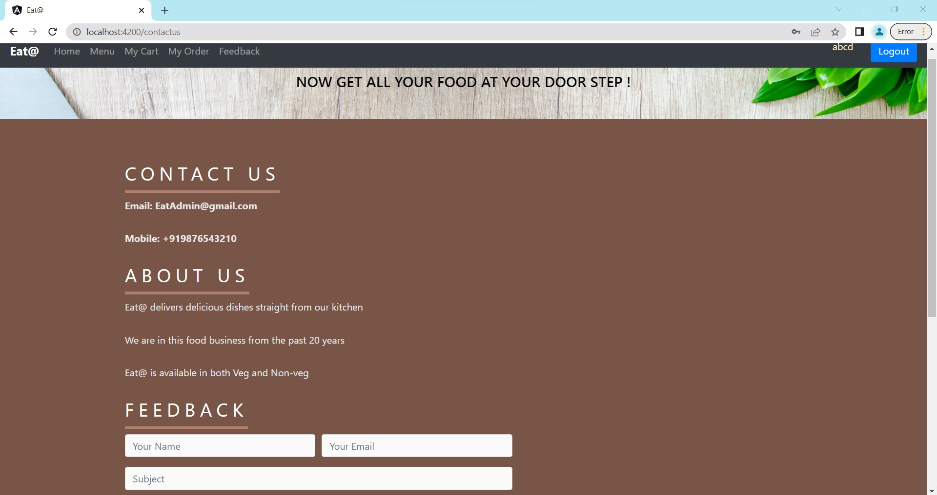

Slide 35
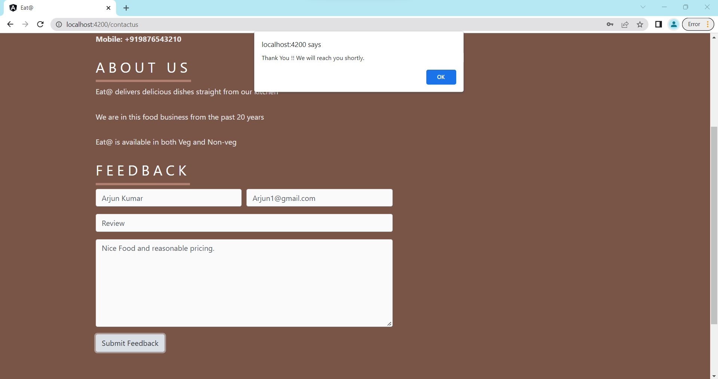

Slide 36
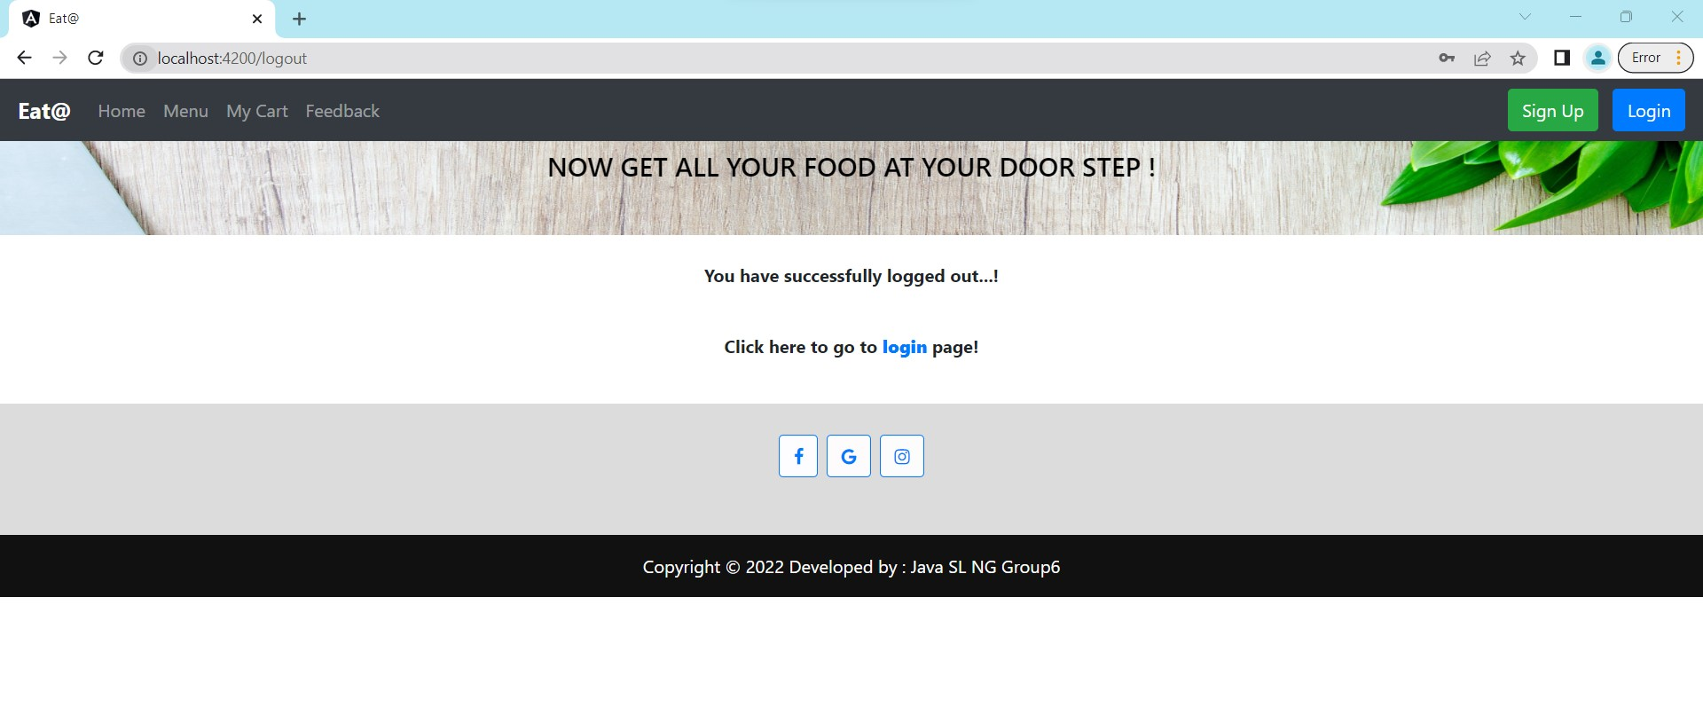

Slide 37
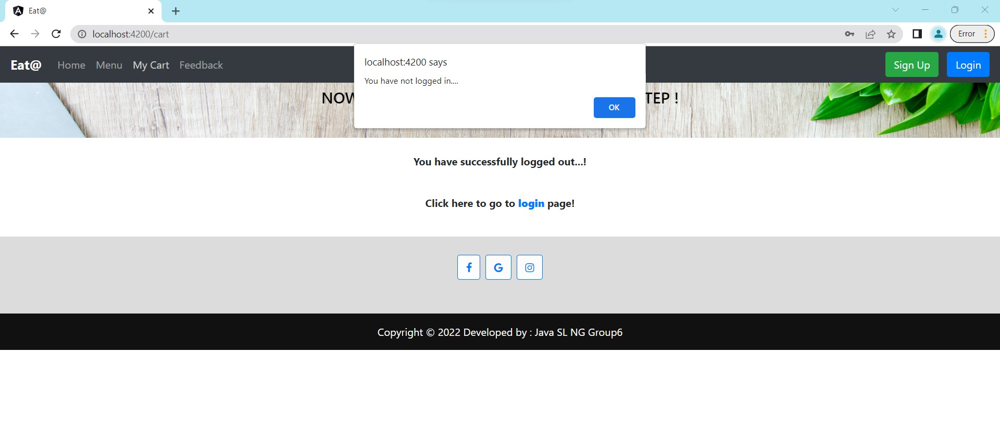

Slide 38
TESTING

Slide 39
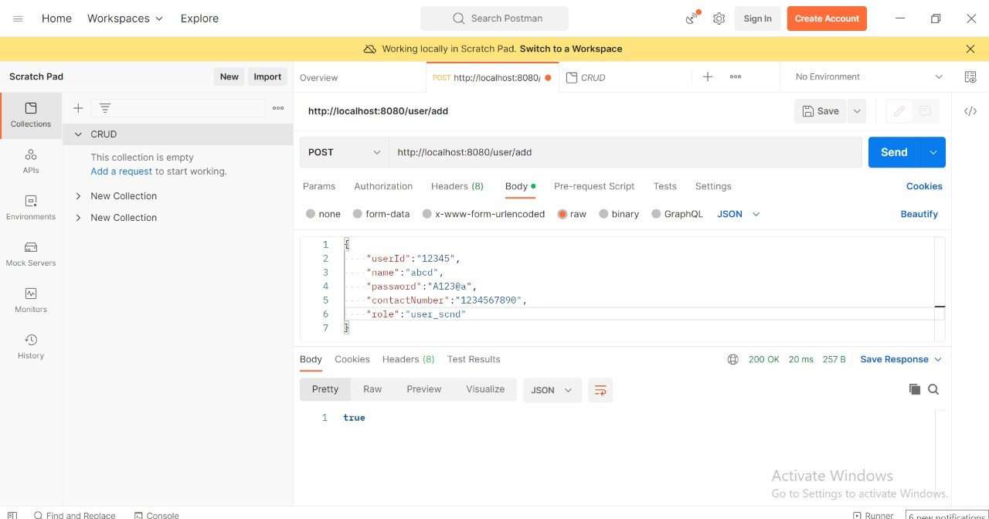
USER – POST:

Slide 40
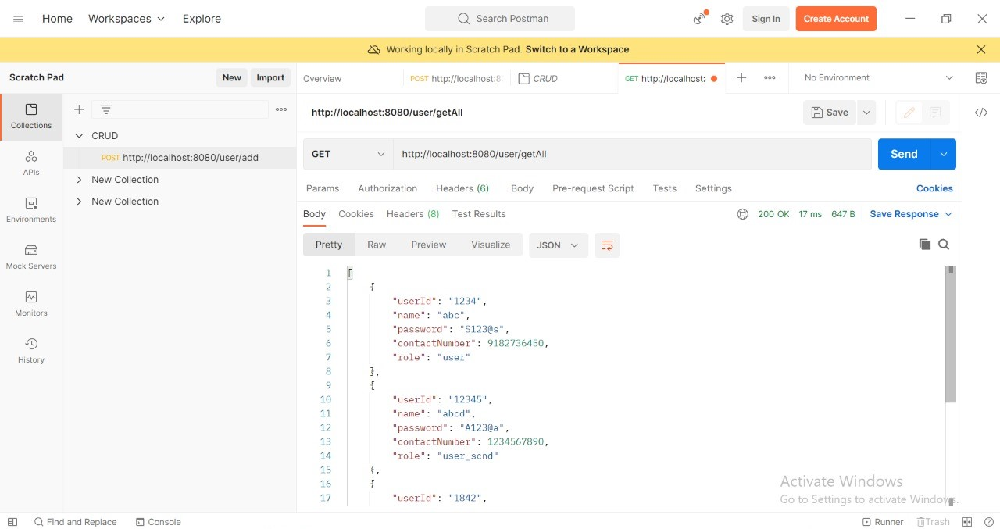
GET-ALL:

Slide 41
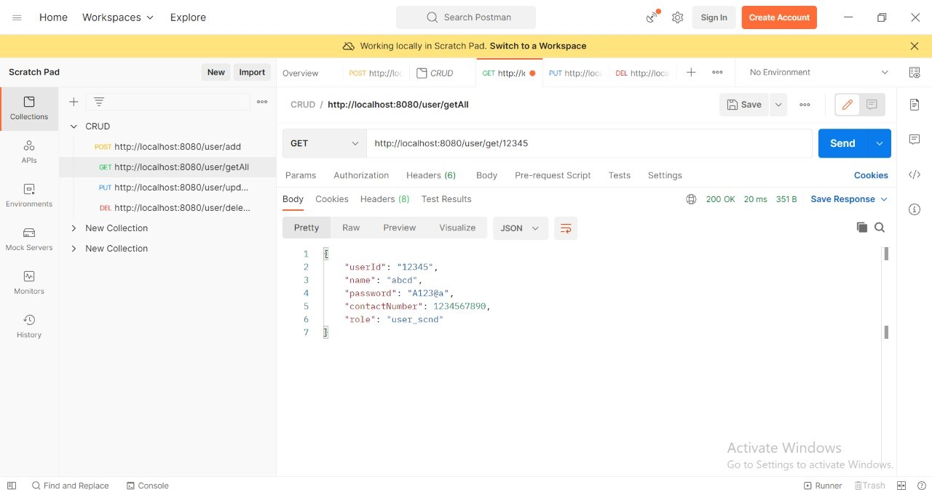
GET WITH USER ID:

Slide 42
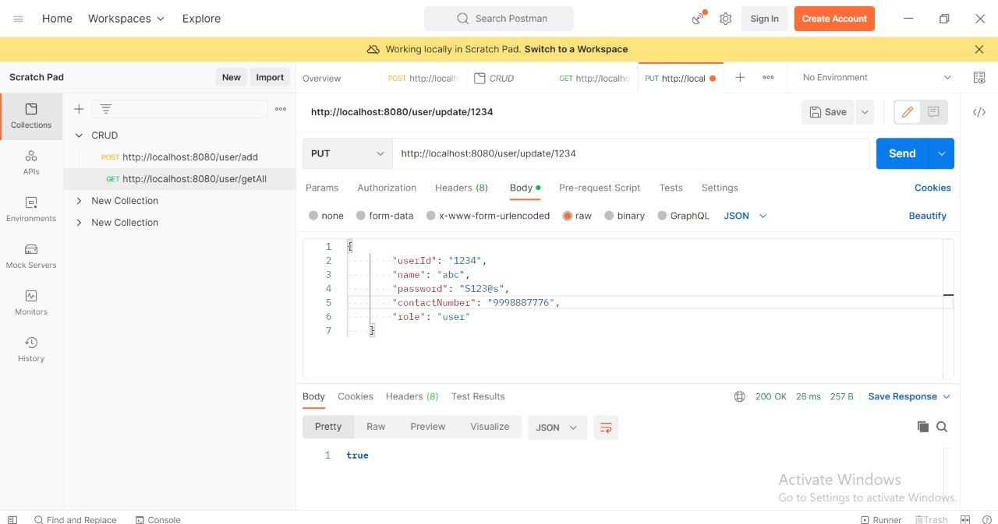
UPDATE:

Slide 43
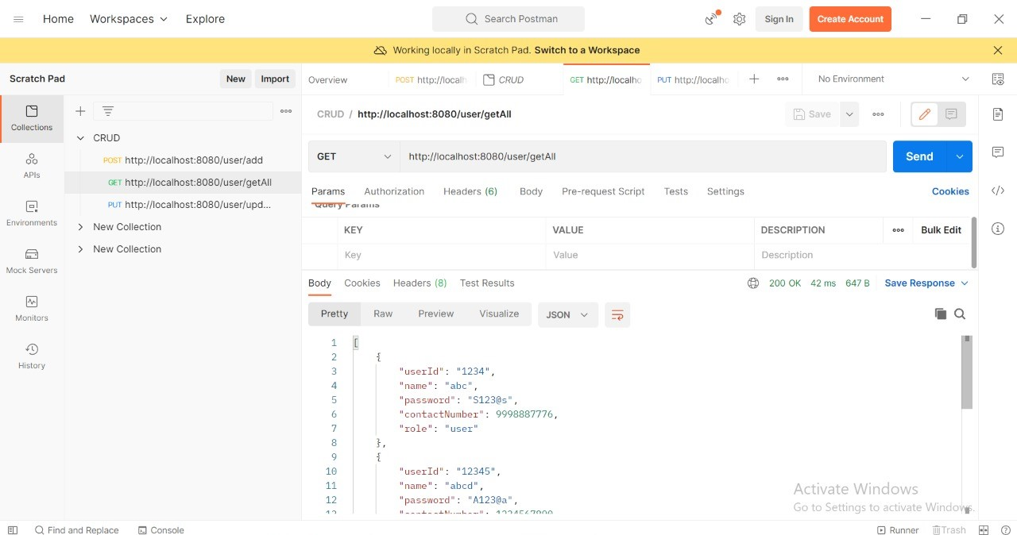

Slide 44
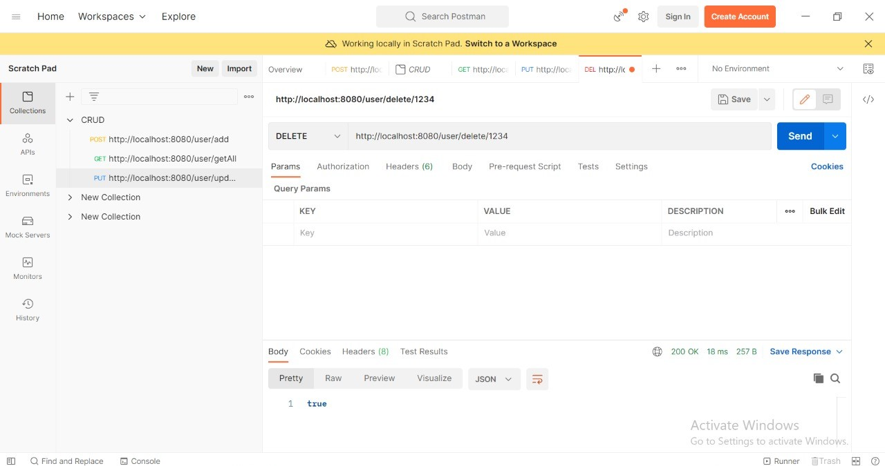
DELETE:

Slide 45
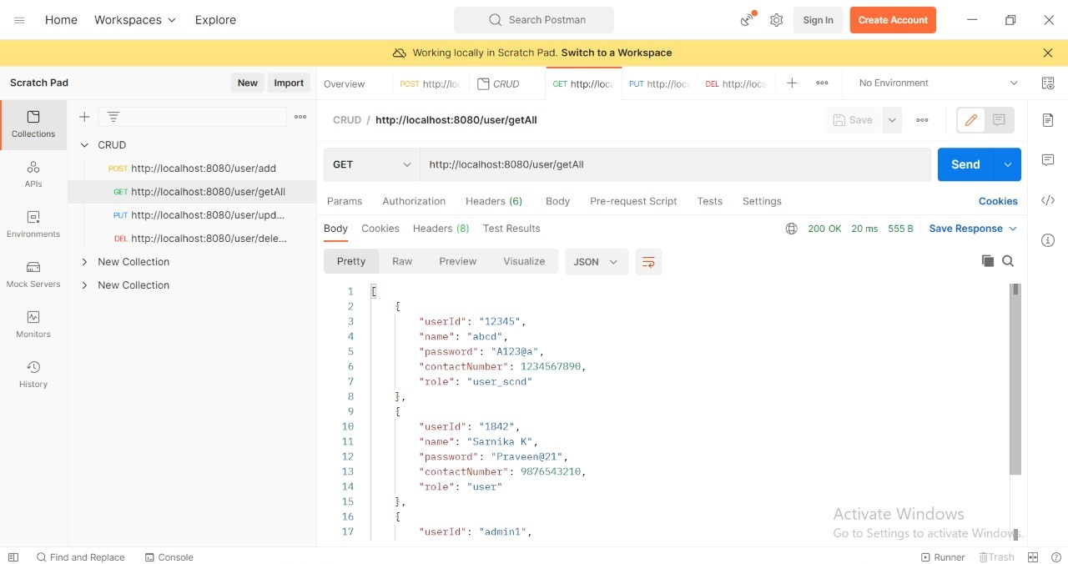

Slide 46
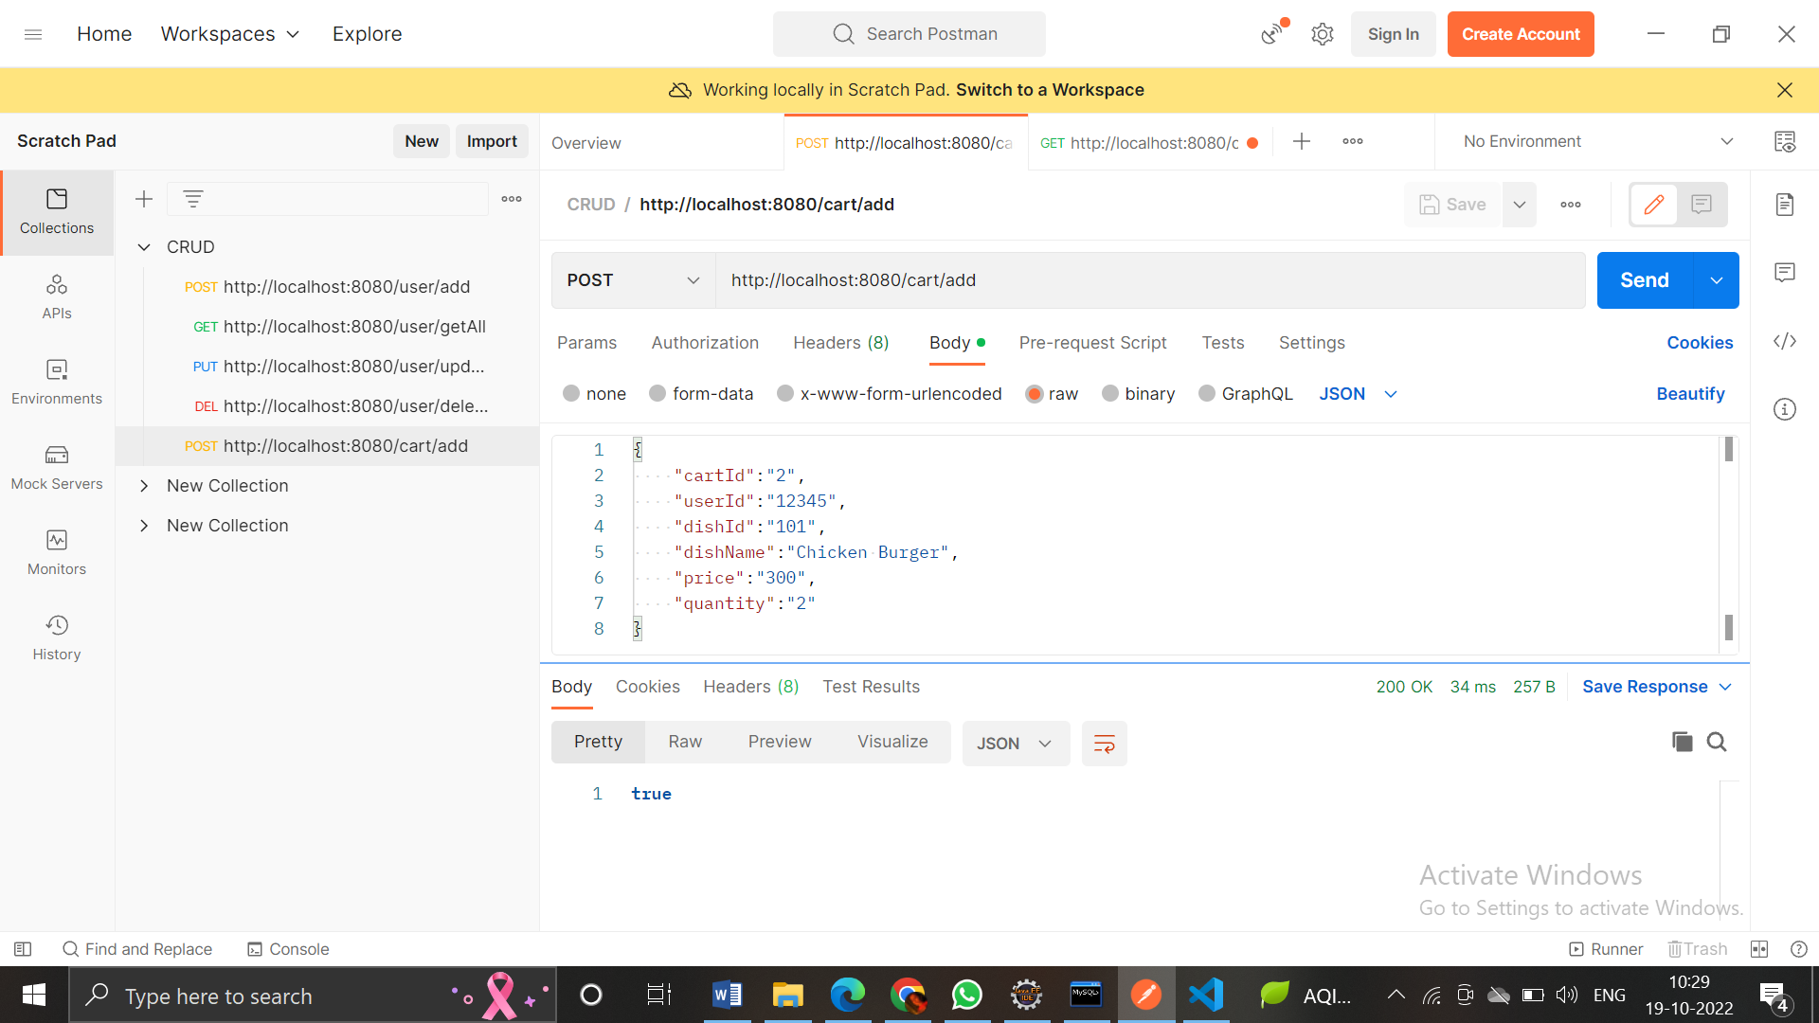
CART - POST

Slide 47
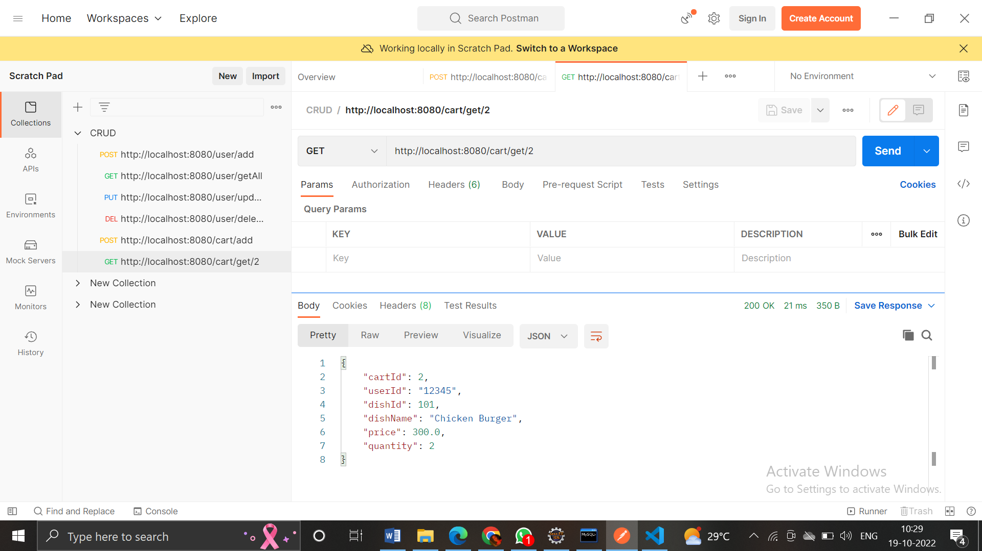
GET:

Slide 48
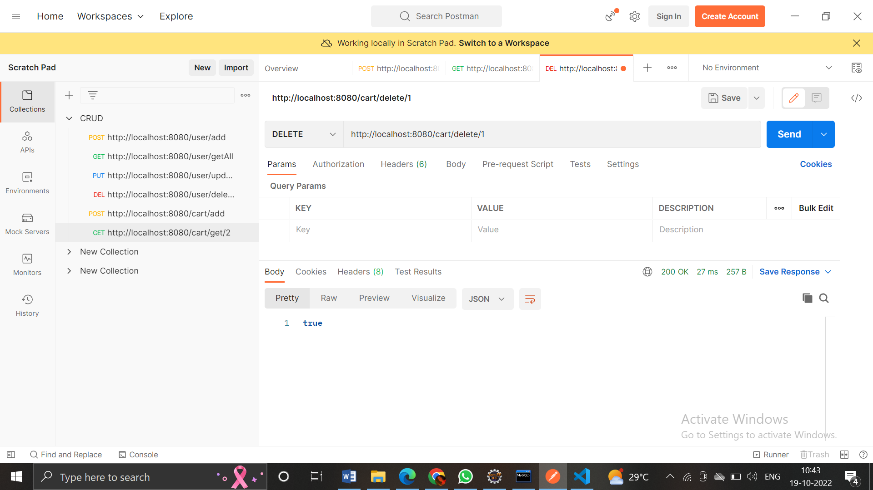
DELETE:

Slide 49
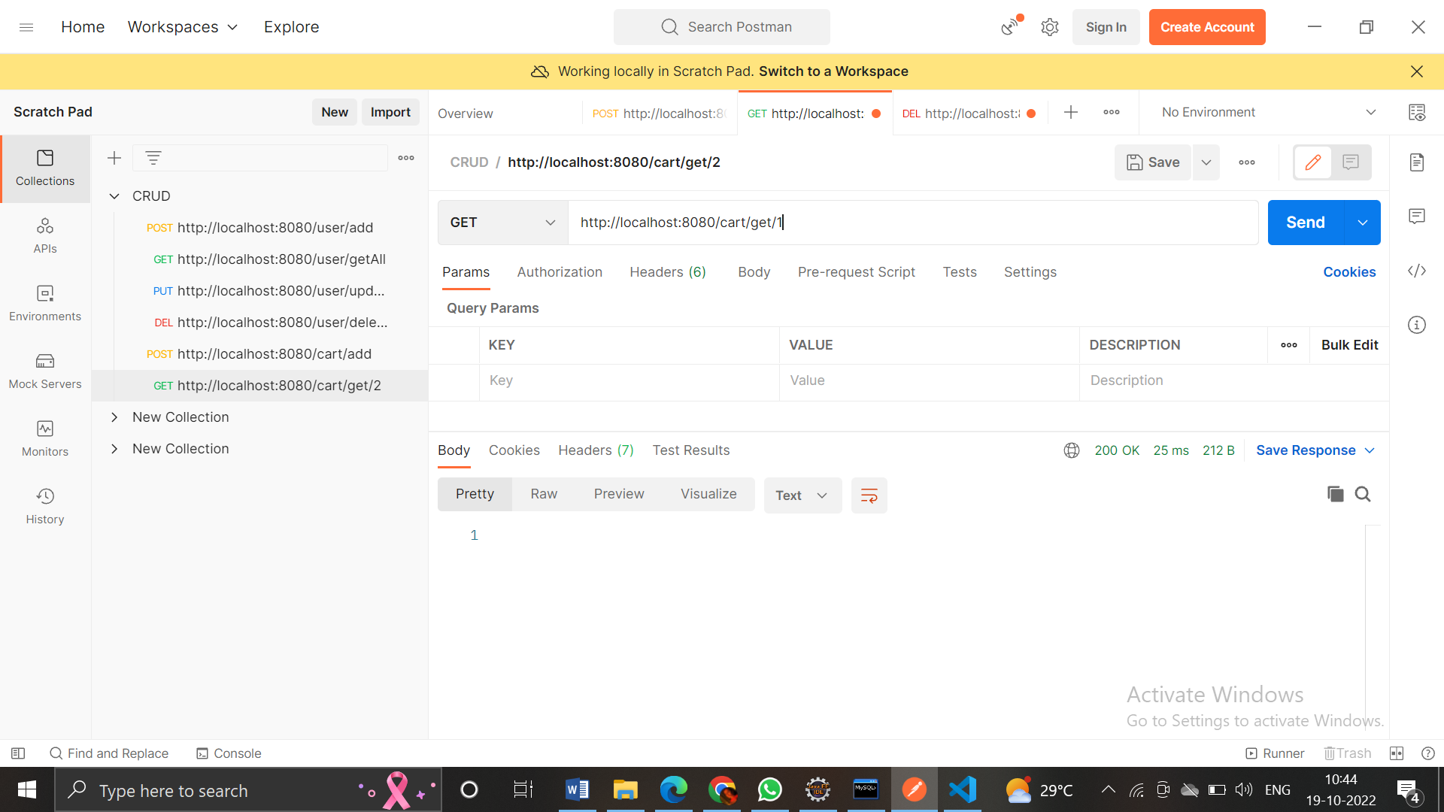

Slide 50
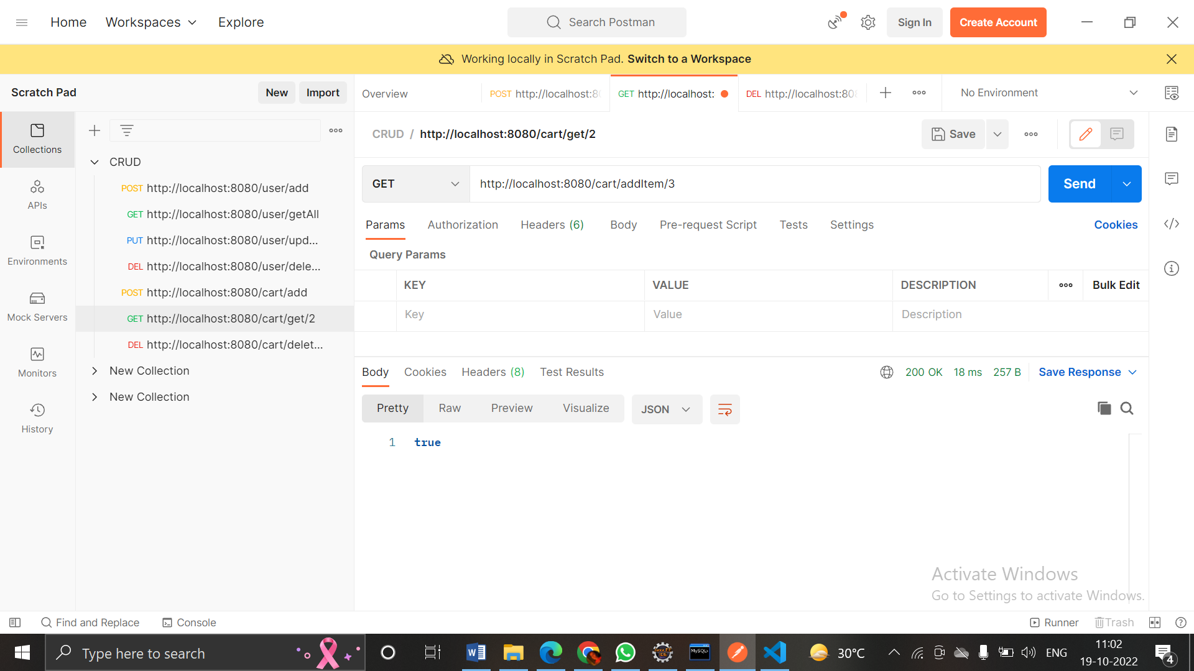
GET:

Slide 51
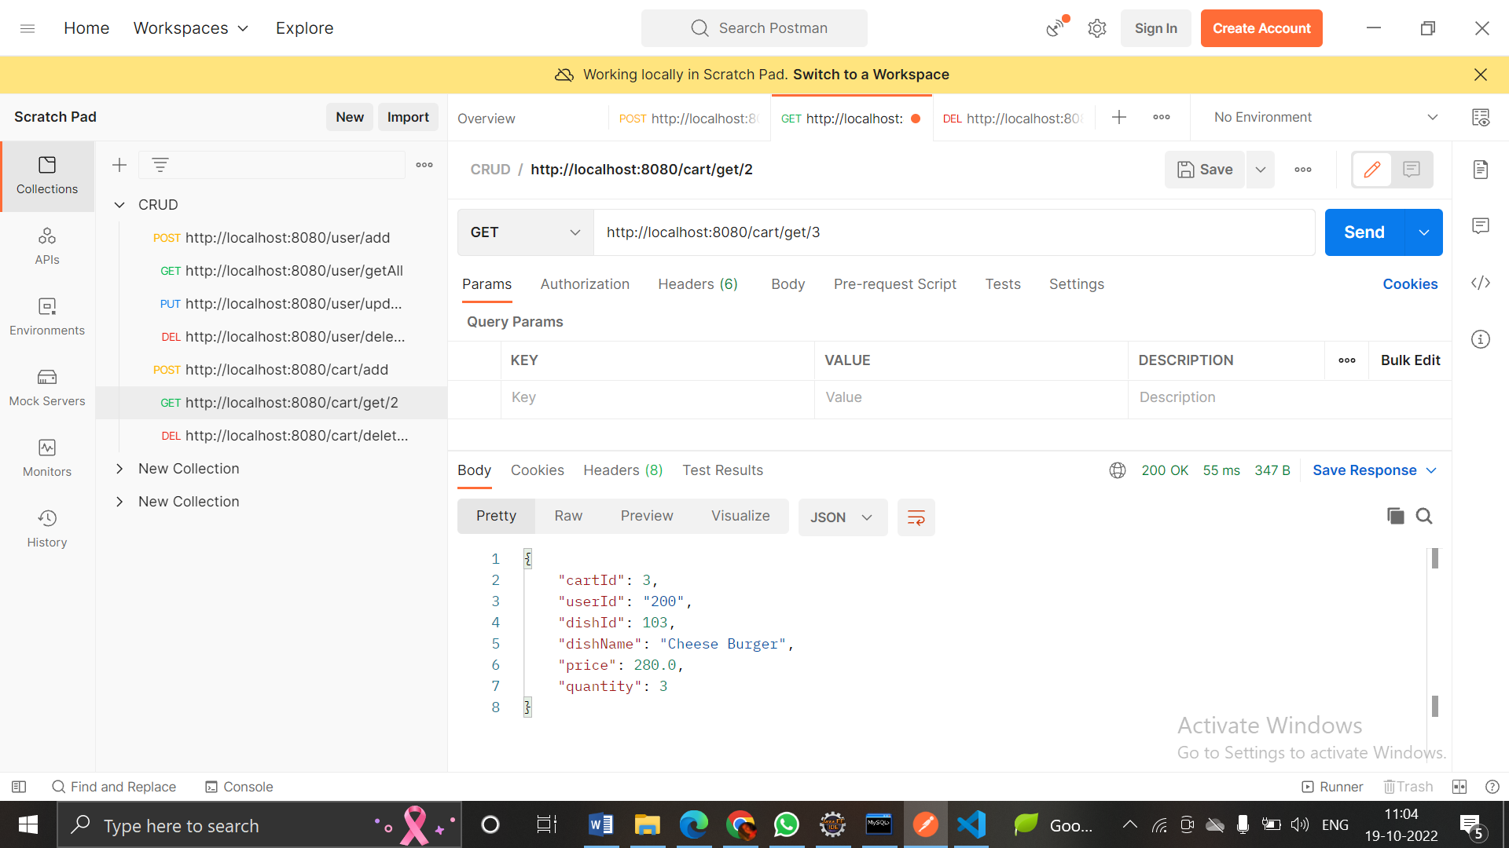

Slide 52
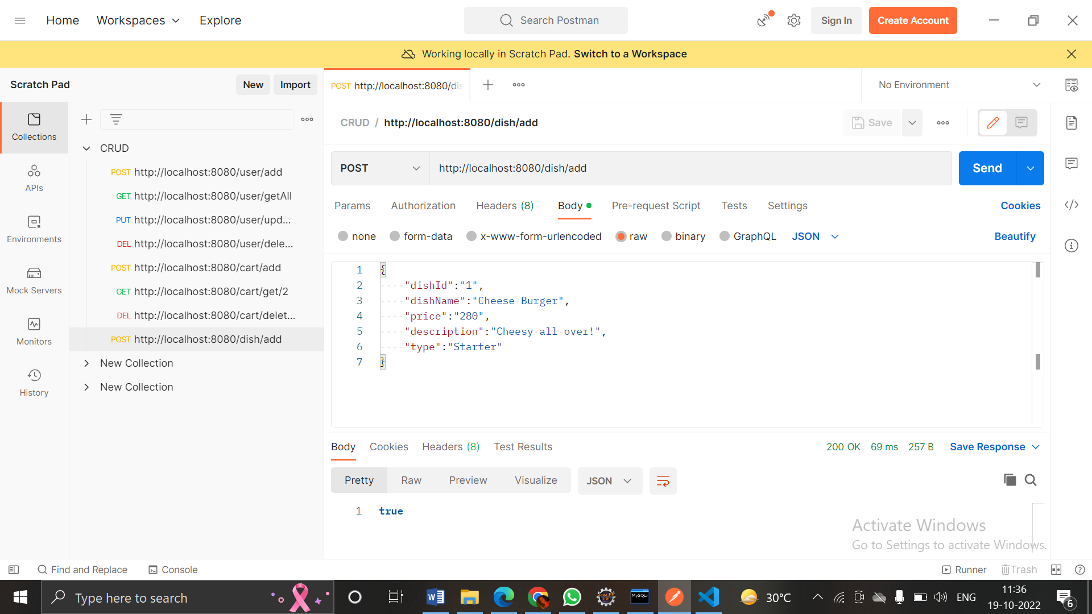
DISH - POST
DISH

Slide 53
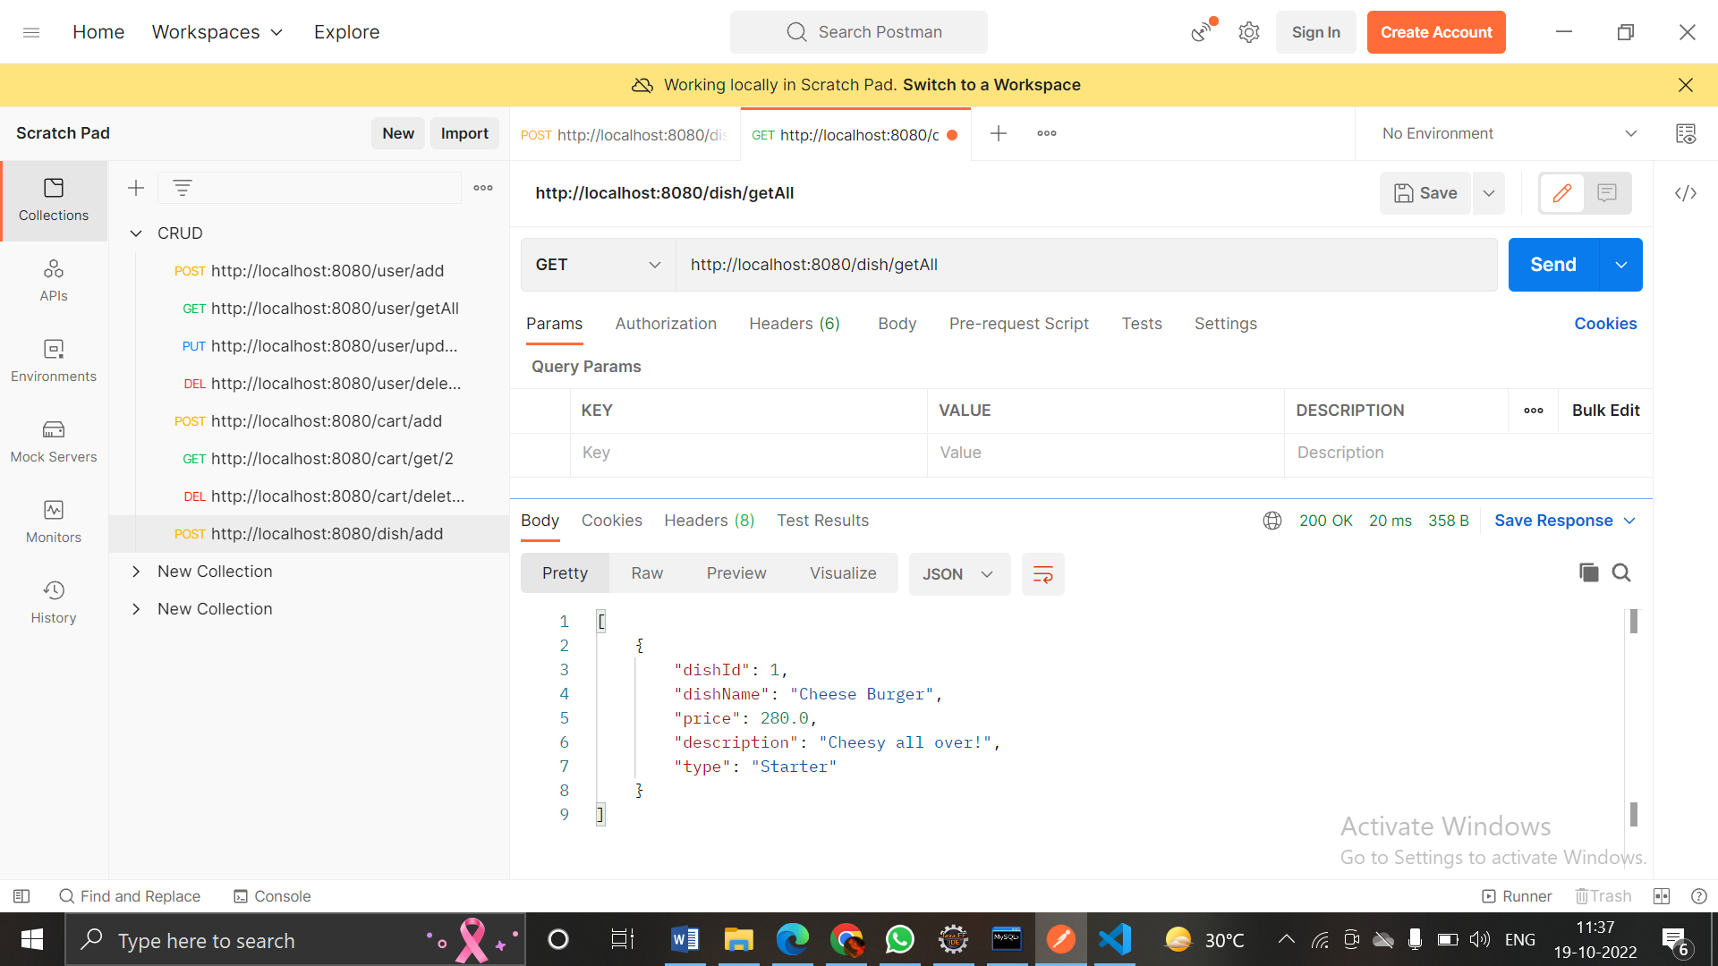
GET:

Slide 54
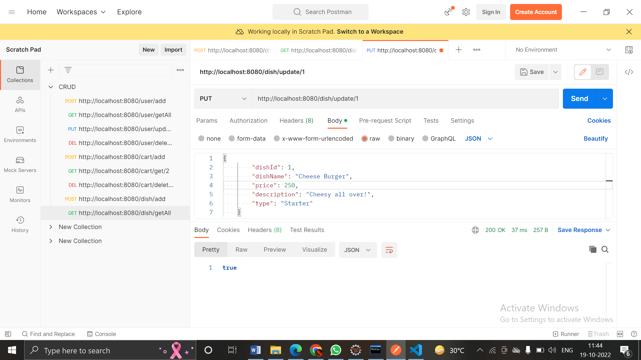
PUT:

Slide 55
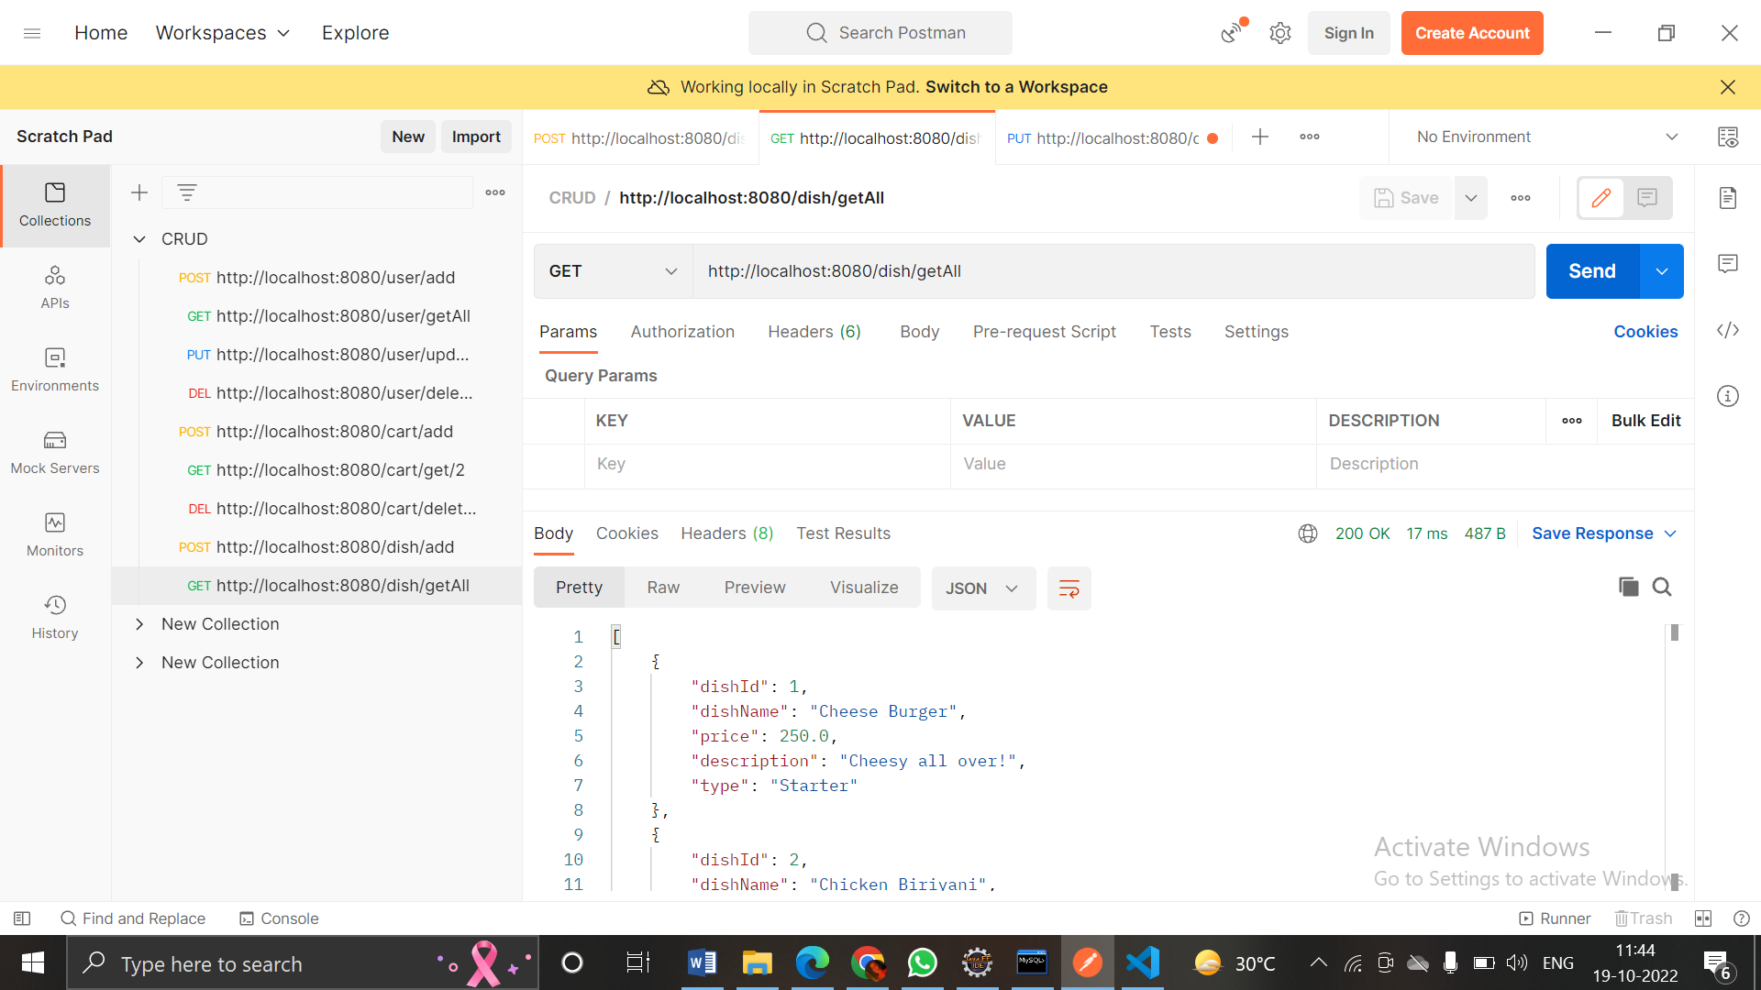

Slide 56
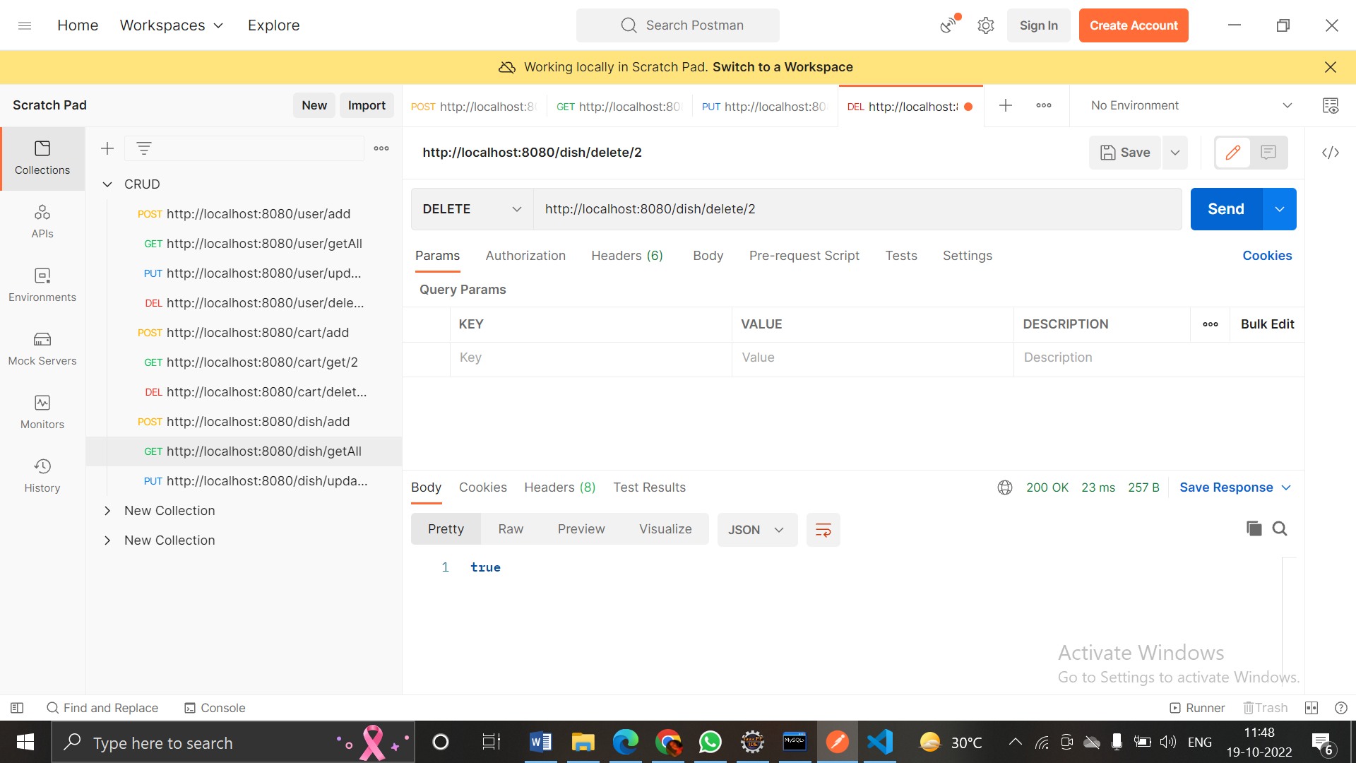
DELETE:

Slide 57
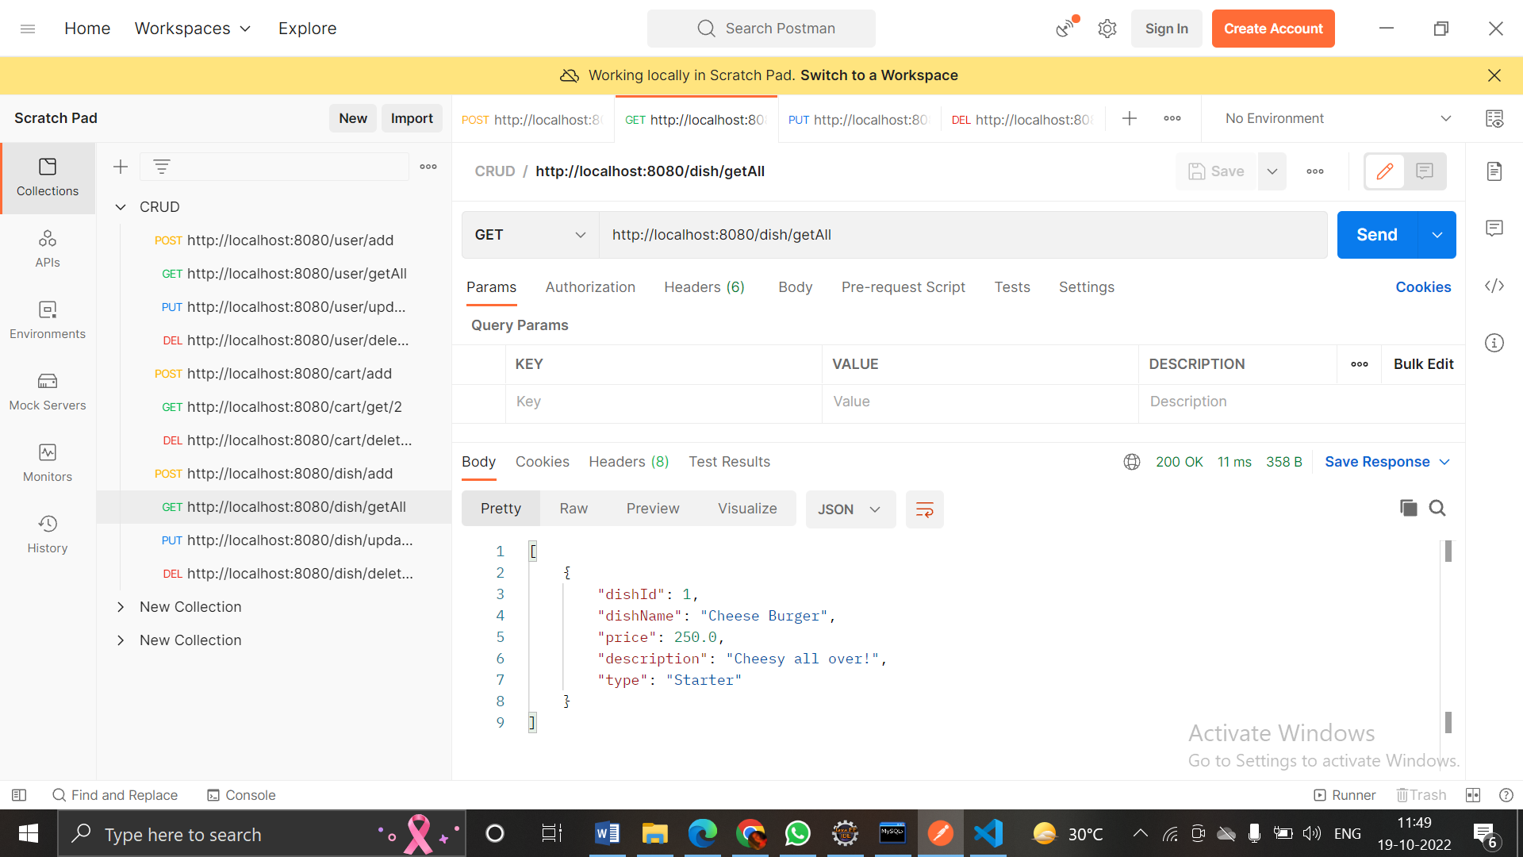

Slide 58
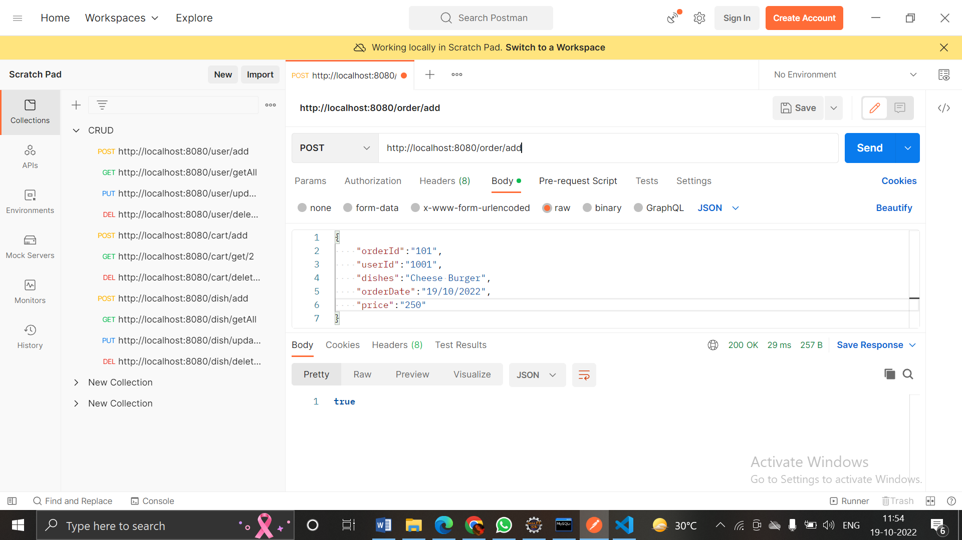
ORDER - POST
ORDER

Slide 59
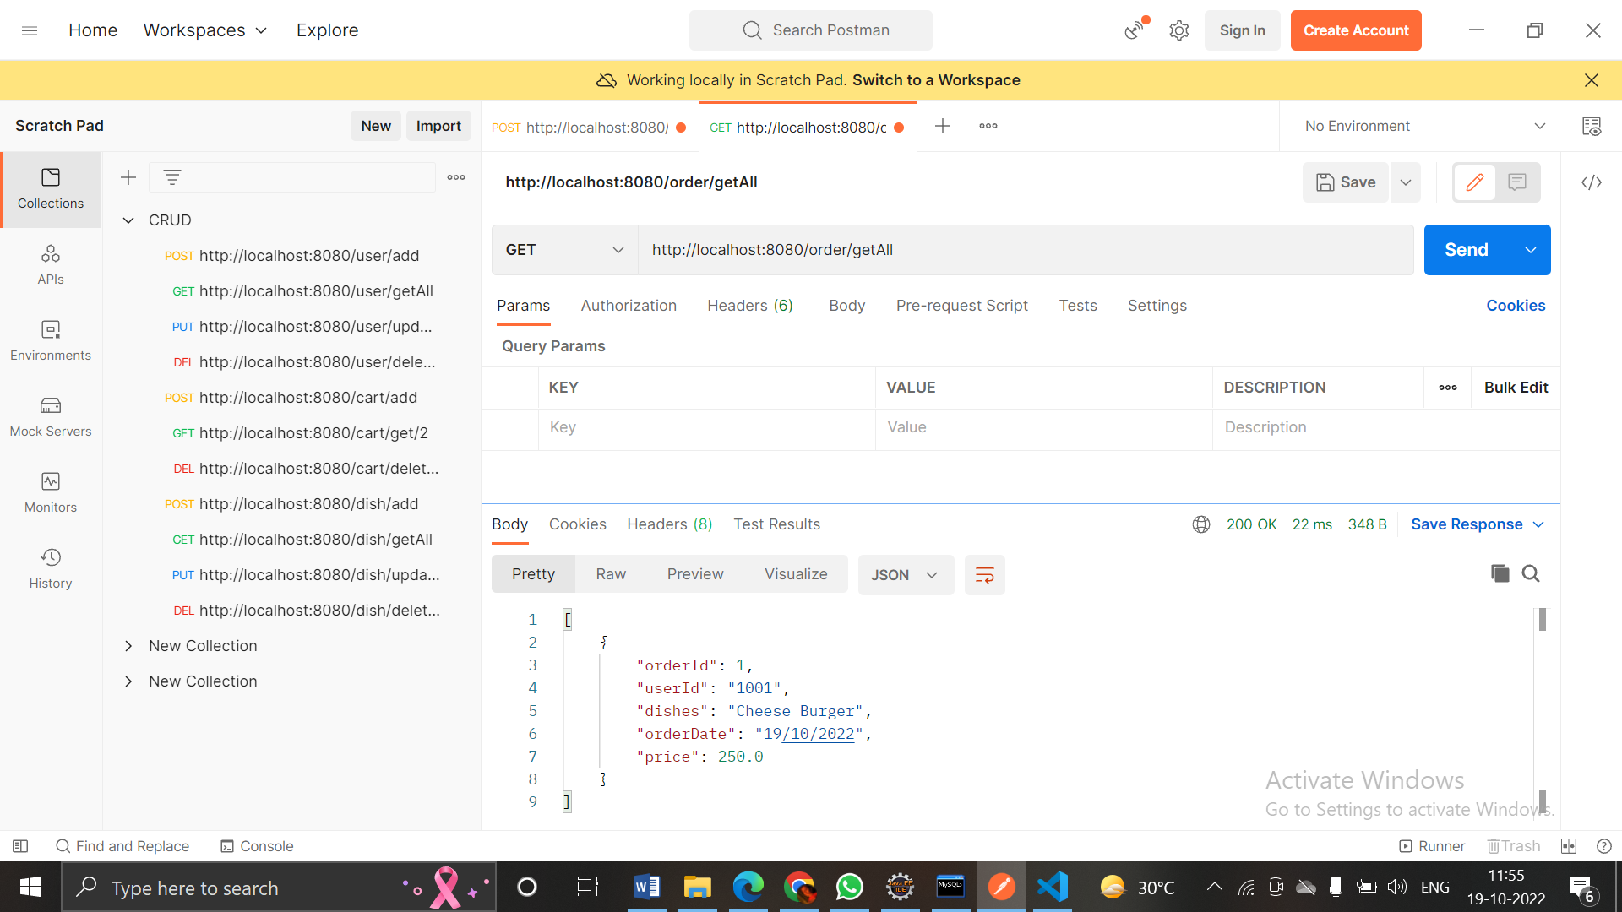
GET:

Slide 60
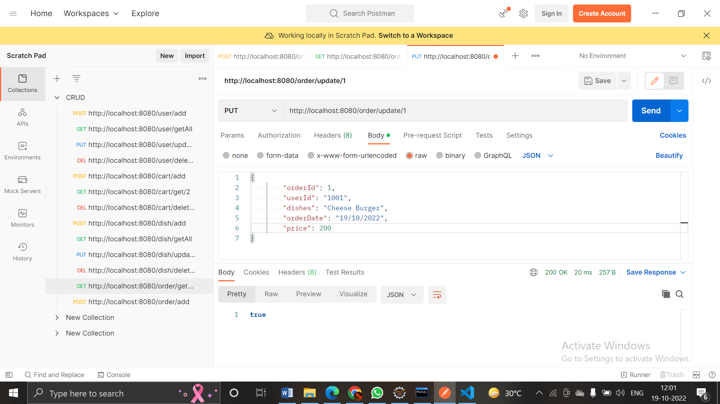
PUT:

Slide 61


Slide 62

DELETE:

Slide 63


Slide 64
THANK YOU!

